Slide 1
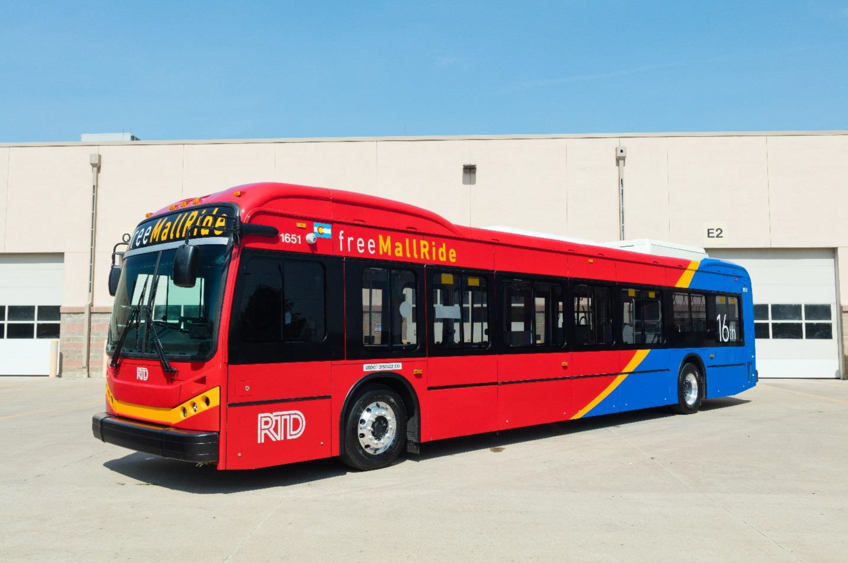
Electrification of the 16th St. Mall Shuttles

Slide 2
Summary
16th Street Mall Operation
RTD Electric Mall Shuttle Buses
RTD Electric Bus Charging Operation
Things to Consider
Questions & Answers

Slide 3
16th Street Mall Operations
“Free” Shuttle service known as “Free Mall Ride”
1.4 miles long along 16th Street between Union Station and Civic Center Station
Opened in 1982 from Broadway (Civic Center Station) to Market Street (Market Street Station)
Designed by Pei Cobb Freed & Partners, with renowned architect I.M. Pei as design partner.

Slide 4
16th Street Mall Operations
Bus stops at every intersection
Runs 4:59 a.m. to 1:21 a.m. weekdays - slightly shorter on weekends and Holidays
Shuttles run 90 sec headways during 3 peak times
Average weekday ridership: 43,971

Slide 5
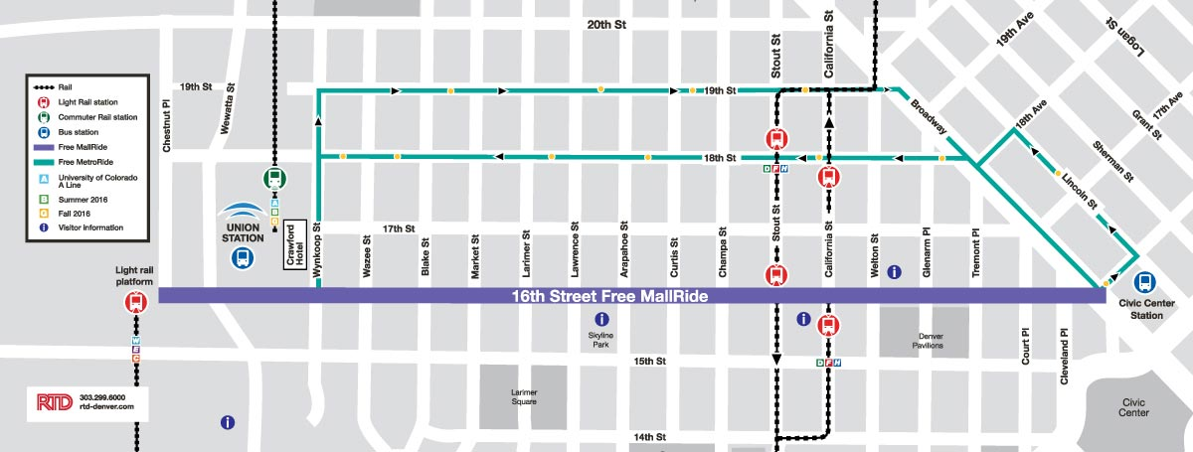
16th Street Mall Operations

Slide 6
RTD Electric Mall Shuttle Buses
Manufactured by BYD in Lancaster, CA
Length: 45’
Curb Weight: about 30,000lbs
Completely Low Floor
Right Hand Drive
Three Passenger Doors and a Driver’s Door
Two Drive Modes: On-Mall and Off-Mall
Two 90 kW Motors (244 hp total)

Slide 7
RTD Electric Mall Shuttle Buses
Driver’s compartment separated from Passenger compartment
Including separate HVAC
Zero Tailpipe Emissions – No Fuel-Fired Heater
ADA Features:
Two Wheelchair Securement Areas
Manual Ramp
Kneeling
Capacity without Wheelchairs: 107 (18 seated + 88 Standees + Driver)

Slide 8
RTD Electric Mall Shuttle Buses
Battery Type: Lithium Iron Phosphate
Battery Capacity: 292 kWh
Battery Packs: 2 Each 540 VDC in Parallel
No external heating or cooling of the batteries is required

Slide 9
RTD Electric Bus Charging Operation
Buses housed at Platte Division
30 Chargers – 10 on each island
Charging Power: 80kW, 480 VAC
Charging Time from 20% to 100%: approximately 3.5 hours
Separate transformer/metered service
Equipment Field Certified by TuV and accepted by city inspector

Slide 10
RTD Electric Bus Charging Operation
Buses equipped with I/O Controls Health Alert Monitoring System
Reports Battery SOC and other data every three minutes via cellular network
Buses are assigned to charging positions and run blocks based on their SOC
Buses are plugged in and unplugged by Service and Cleaning personnel.
Charging conditions are monitored remotely via the internet.

Slide 11
RTD Electric Bus Charging Operation
Charging Issues and Improvements
Demand Charges
Smart Charging

Slide 12
Things to Consider
Usage – What is the Duty Cycle?
How much heating and cooling is required?
Hills?
Driver Behavior – Acceleration and Regeneration curves are programmable.
Cost and Availability of Electricity
Battery Capacity and Type of Charging
Tradeoff between battery capacity and on-route charging
Conductive
Fast, on route or in depot, moving parts -> maintenance
Inductive
Slower but no moving parts

Slide 13

Things to Consider
Visually Impaired Pedestrians
We installed noise generators
Maintenance
No perfect bus – How is the support from the OEM?
How long is the battery warranty? What are the parameters defining end of life?
Technician skill set somewhat different from diesel buses.
How will you protect yourself from hardware and software obsolescence?
Financial Strength of the Manufacturer – Will they be around for the life of the bus?

Slide 14
Questions
?

Slide 15
Questions
Annual Emissions Reduction per Bus*
Assumptions:
Western US Energy Production (WECC)
CNG MPDGE: 2.46
Electric MPDGE: 16.1
Annual Mileage: 12,700
* Using the Heavy Duty Emissions Calculator from Argonne National Lab

Slide 16
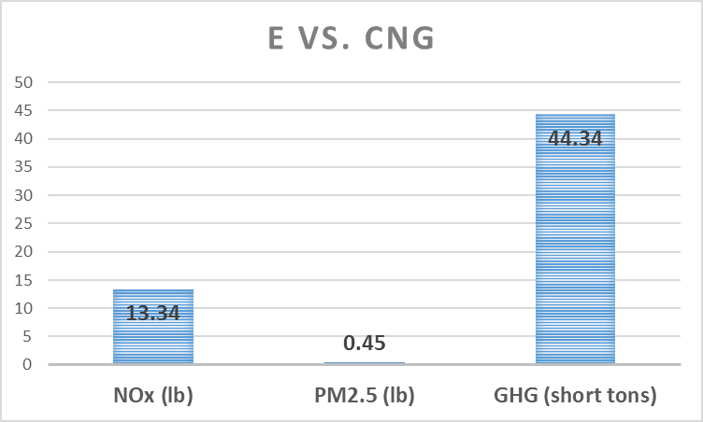
Questions
Annual Emissions Reduction per Bus

Slide 17
Operational Costs

