Slide 1
City of Porterville
Richard Tree
Notes:
Welcome and brief introduction

Slide 2

Preparing for
Zero Emission Buses

Slide 3

WHERE DO WE START
https://homeworlddesign.com/bus-stop-in-baltimore/
Notes:
Let’s start with telling you a little about the City of Porterville.

Slide 4
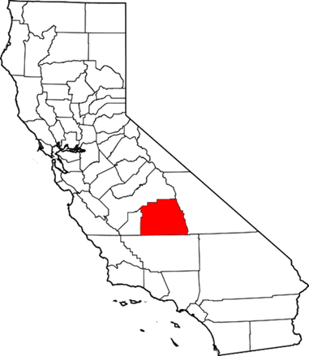
City of Porterville
Located in California
Central San Joaquin Valley
Largest Agricultural-producing county in the world

Slide 5

Air Quality
Worst Air Quality in the U.S. (World Health Organization)

Slide 6
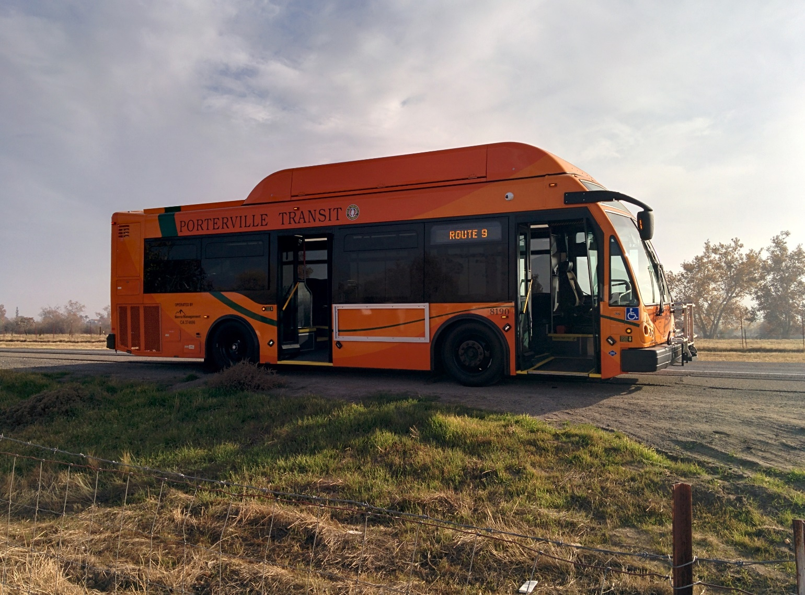
Porterville Transit
*Pre ZEB
100% CNG
18 Buses
9 Routes
660,000 Annual Ridership

Slide 7
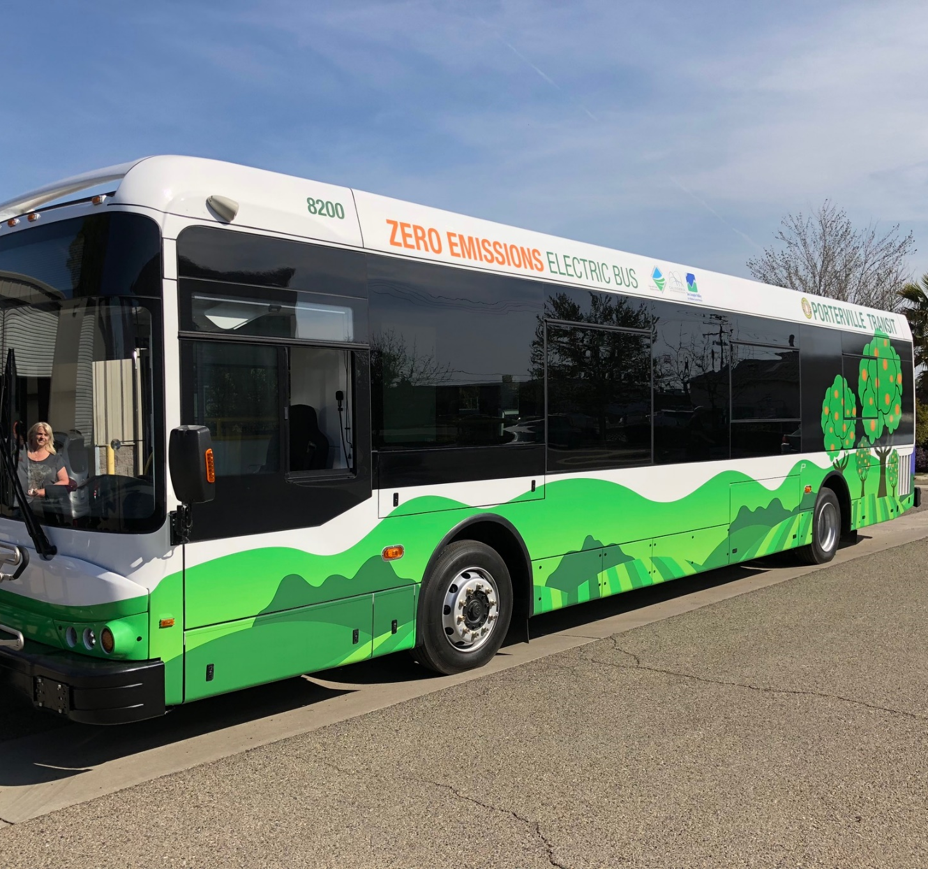
Porterville Transit
10 Battery Electric Buses
11 200kw Charging Stations
80kw Renewable Energy
1 Rescue Truck
100% ZEB Daily Service

Slide 8
MY TOP 10
Electric Drive!
Notes:
I would like to propose my Top 10 List to help you prepare for your Electric Drive!

Slide 9
#1
Identify Your Barriers

Slide 10

#1 – Infrastructure
#2 – Utility Rate Structure
#3 – Knowledge
#4 – Transit Service Requirements
#5 – Commitment

Slide 11
#2
Looming Regulations

Slide 12
Innovative Clean Transit Regulation
ZEB Purchase Requirement
Large Fleets (>=100 buses) | Medium Fleets (30-99 buses) | Small Fleets (<30 buses)
2020 – 25% | - | -
2023 – 50% | 2023 – 50% | -
2026 – 75% | 2026 – 75% | 2026 – 75%
2029 – 100% | 2029 – 100% | 2029 – 100%
Public Workshop on the Proposed
Innovative Clean Transit Regulation
Discussion Document
December 15, 2017
California Air Resources Board

Slide 13
2030 Zero Emission Bus Goal
Requires Action Now

Slide 14
#3
Commitment

Slide 15
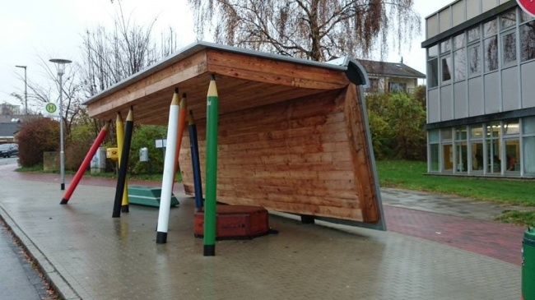
Public
Board
Elected Officials
Local Air District
Staff
http://amazingideas.co/examples-perfect-urban-design-will-denitely-like/

Slide 16
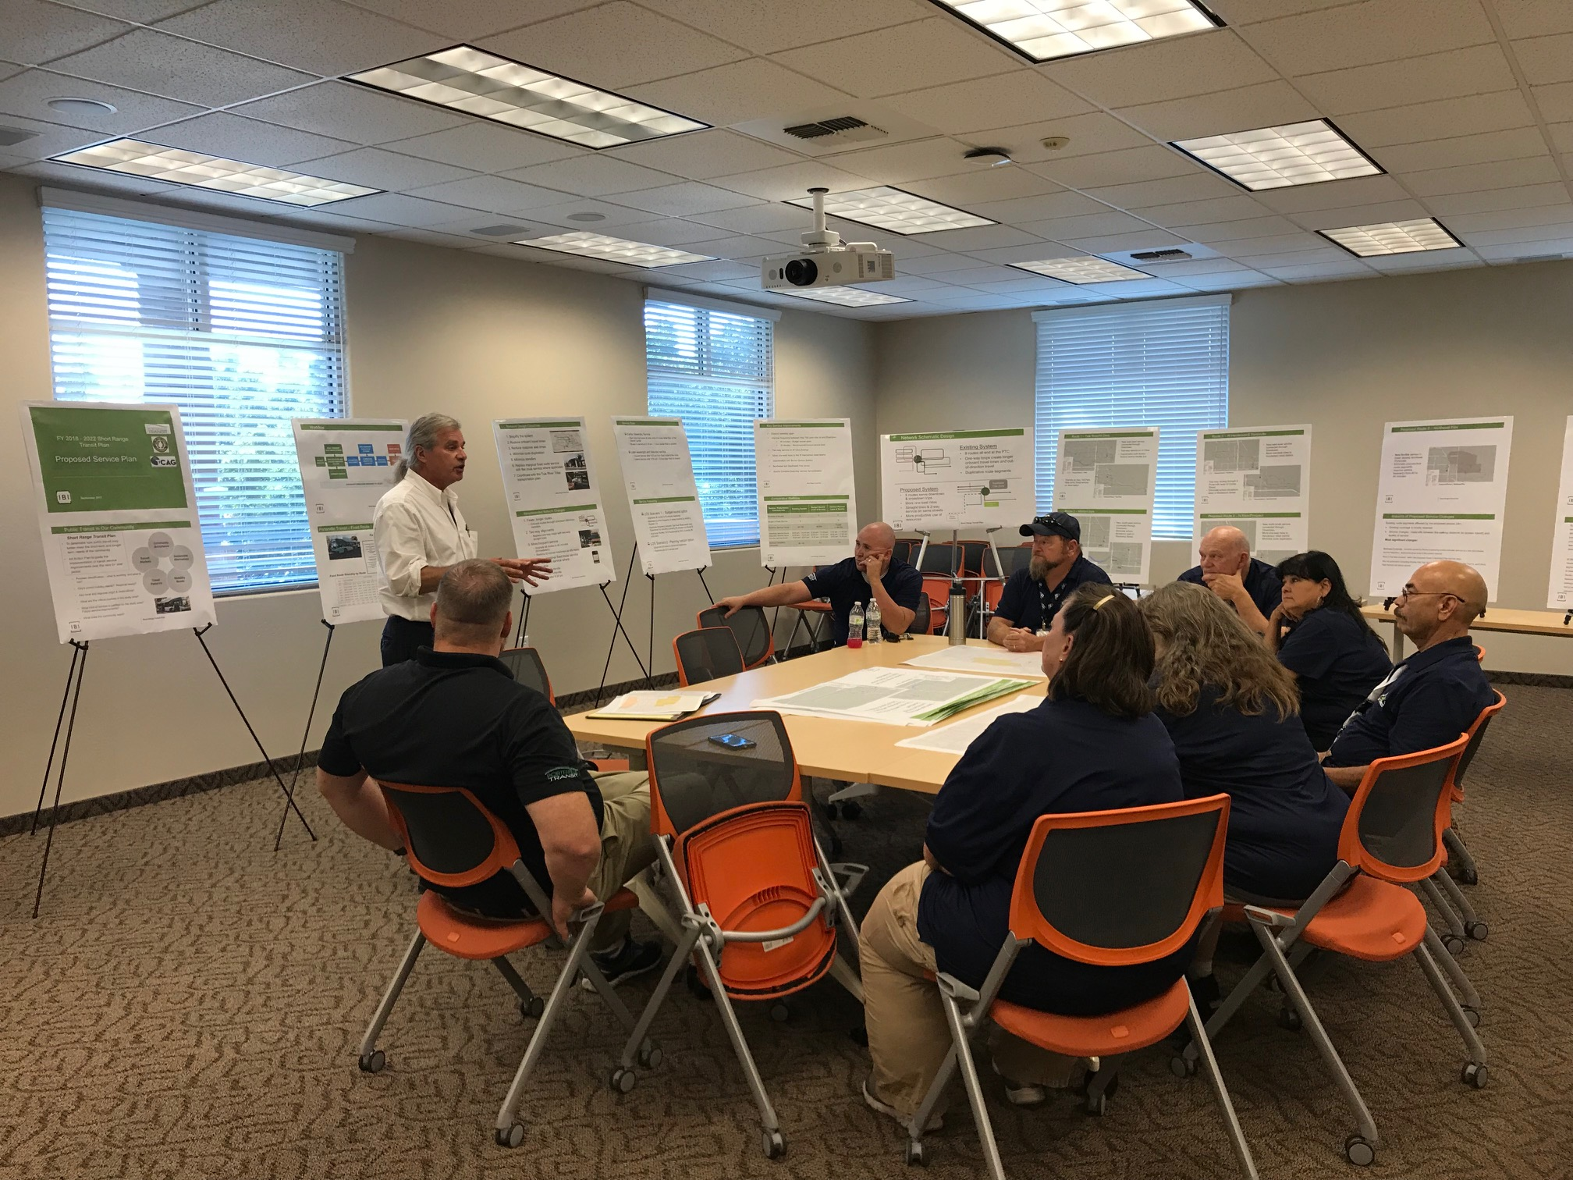
Include Everyone
Notes:
The more you communicate to your public, operators, and maintenance staff the more acceptance and buy in you will get in return.

Slide 17
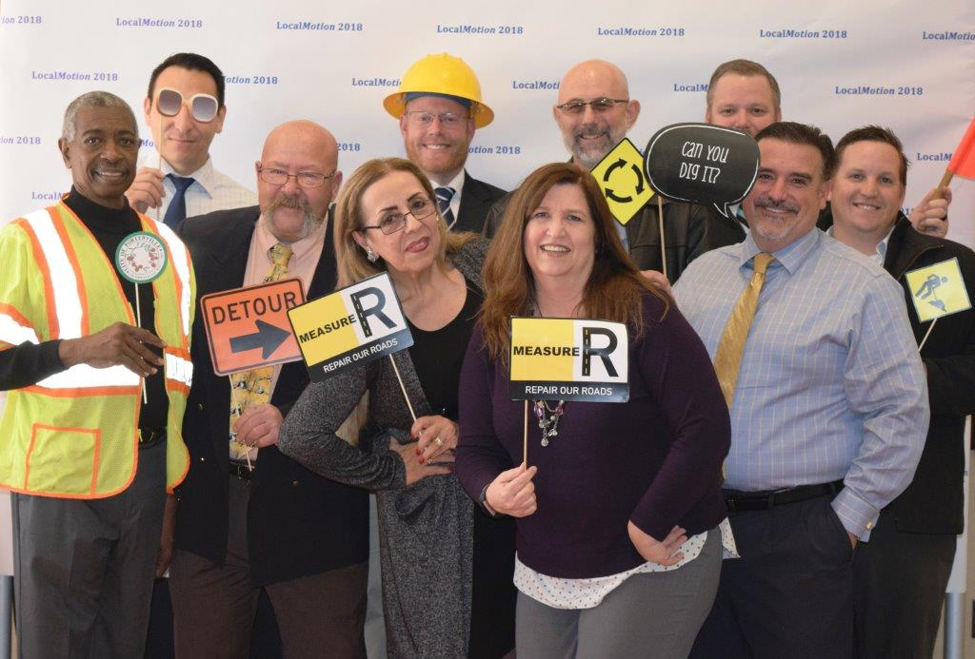
Notes:
Include everyone, you will thank yourself when you are challenged.

Slide 18
#4
Seek Funding NOW
Notes:
You may have noticed that I didn’t include funding as a barrier. Funding zero emission vehicles is a top priority on both the federal and state level

Slide 19

Notes:
The City of Porterville is a small urban transit provider and funding is very limited. However, if you adopt early you have a better chance of securing funding before it gets really competitive.

Slide 20

Funding
- Federal
- State
- Local
http://www.brandtuitive.com/nespresso-out-of-home/

Slide 21
Major Funding Programs in California
Provider | Program
FTA | National LoNo – over $100M since 2014 Section 5307 Capital Funds
Air Resources Board (Cap and Trade) | Zero-Emission Bus Pilot Commercial Deployment Project Hybrid and Zero-Emission Truck and Bus Voucher Incentive Project
Air Resources Board | Low Carbon Fuel Regulation
California State Transportation Agency (CalSTA) | Transit and Intercity Rail Capital Program (TIRCP)
Caltrans | Low Carbon Transit Operations Program (LCTOP)
Local Air Districts | Public Benefits Grant
Finance Options | Lease Options Battery Financing
* Not a complete list

Slide 22
California Air Resources Board
$10.3M to pilot 10 zero-emission buses and 11 charging stations

Slide 23
#5
Utility Provider Is Your Partner

Slide 24
Support Increased EV Adoption
Notes:
Your Utility Provider have set goals to support increased EV adoption across all customer types and to improve the environment.

Slide 25

Help Remove Barriers

Slide 26
Infrastructure – Rebates, Grants, Etc.
Rate Structure – Designed To Encourage Adoption, Cost-Effectiveness
Collaboration – Pilot Projects, Design, Future Needs

Slide 27
#6
Include Maintenance Staff

Slide 28
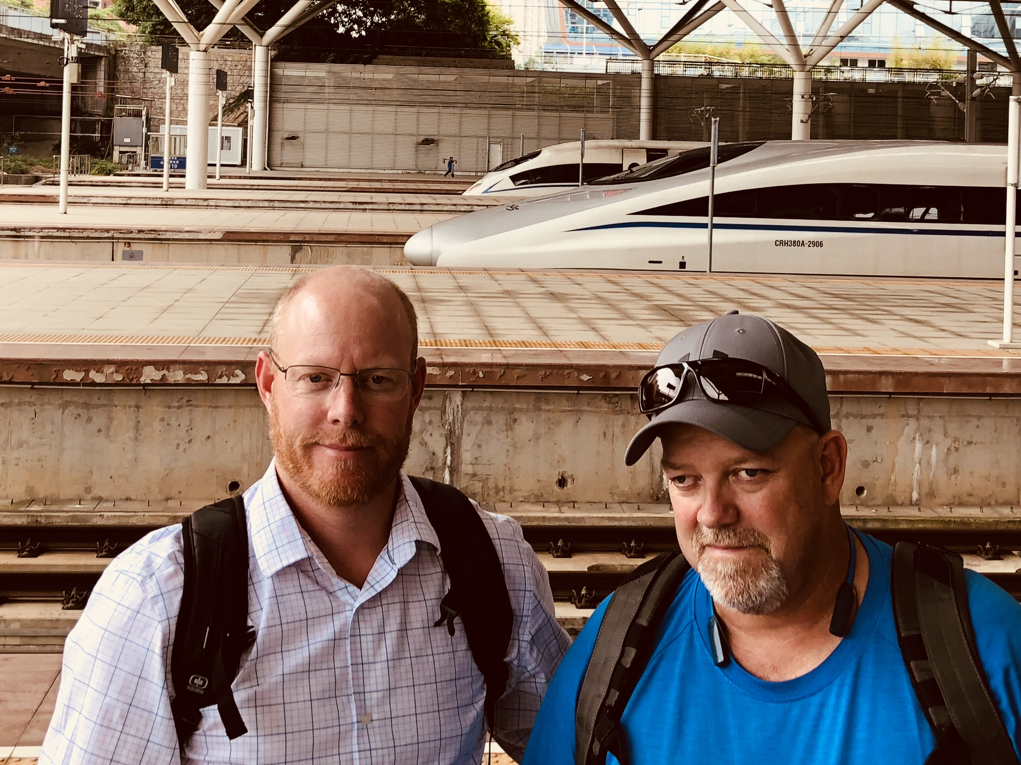
Notes:
That’s Rich and Russell traveling around China learning all they can about EV’s

Slide 29
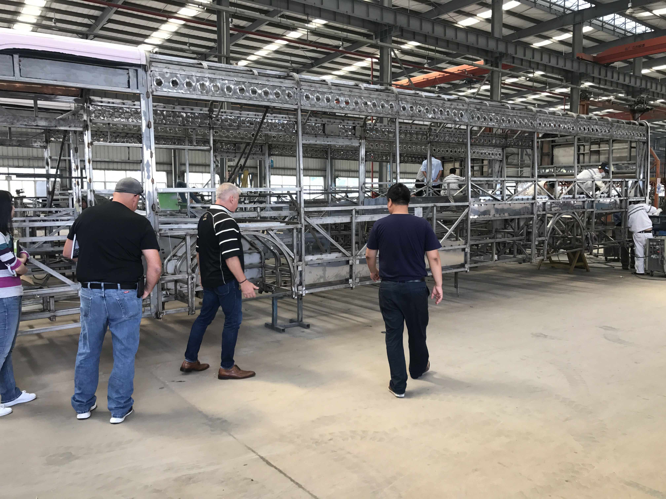
Your Biggest Champion
Notes:
If they feel involved from the beginning they will be your biggest Champion

Slide 30
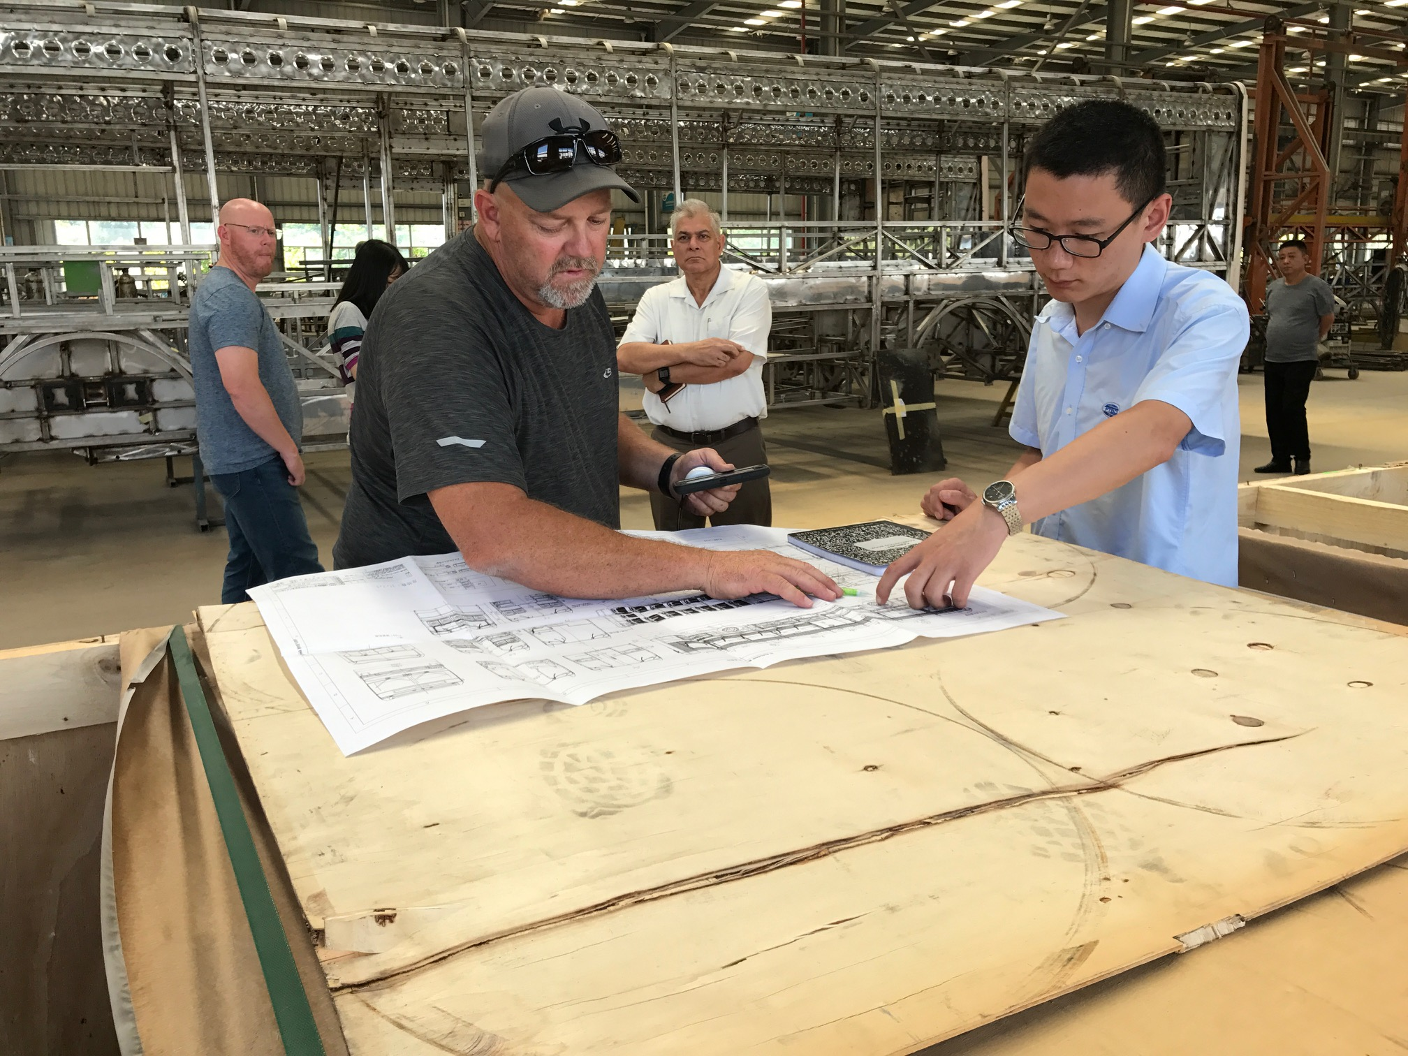
Notes:
They will fully understand what they will be maintaining

Slide 31
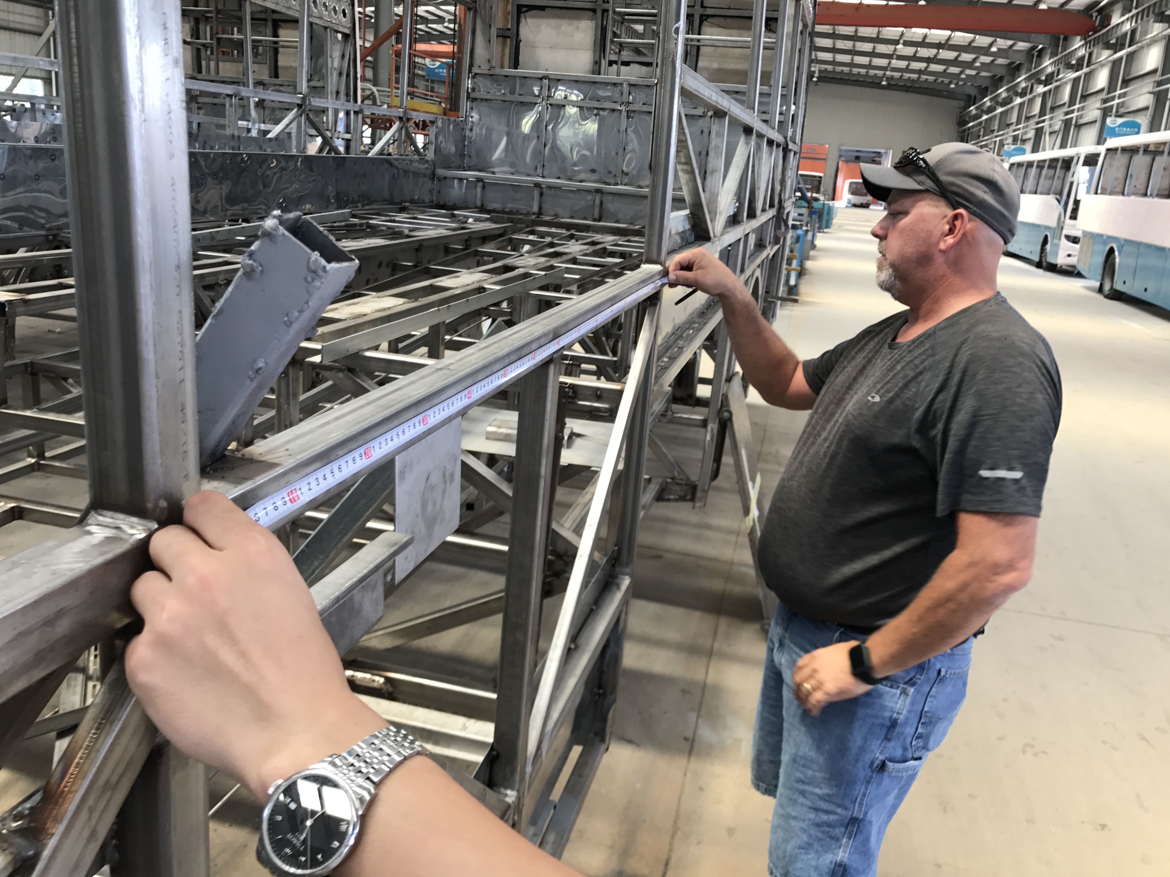
Notes:
Eliminating any fears they have!

Slide 32
#7
Charging Standard?

Slide 34
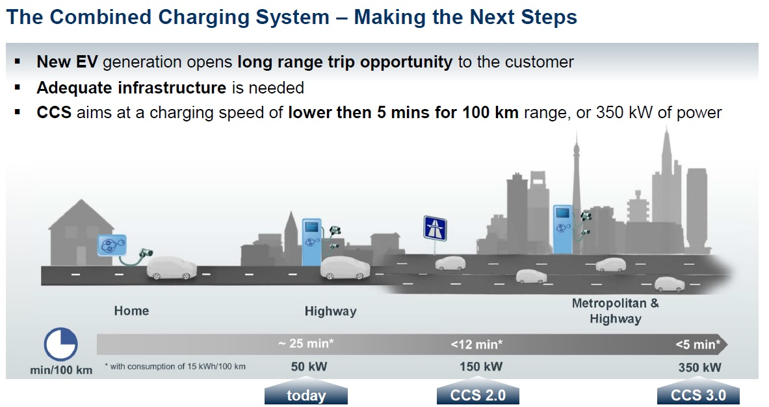

Slide 35
-Rich Tree
“It Is Important To Consider Your Entire Fleet (light, medium, heavy) when considering your charging standard.”

Slide 36
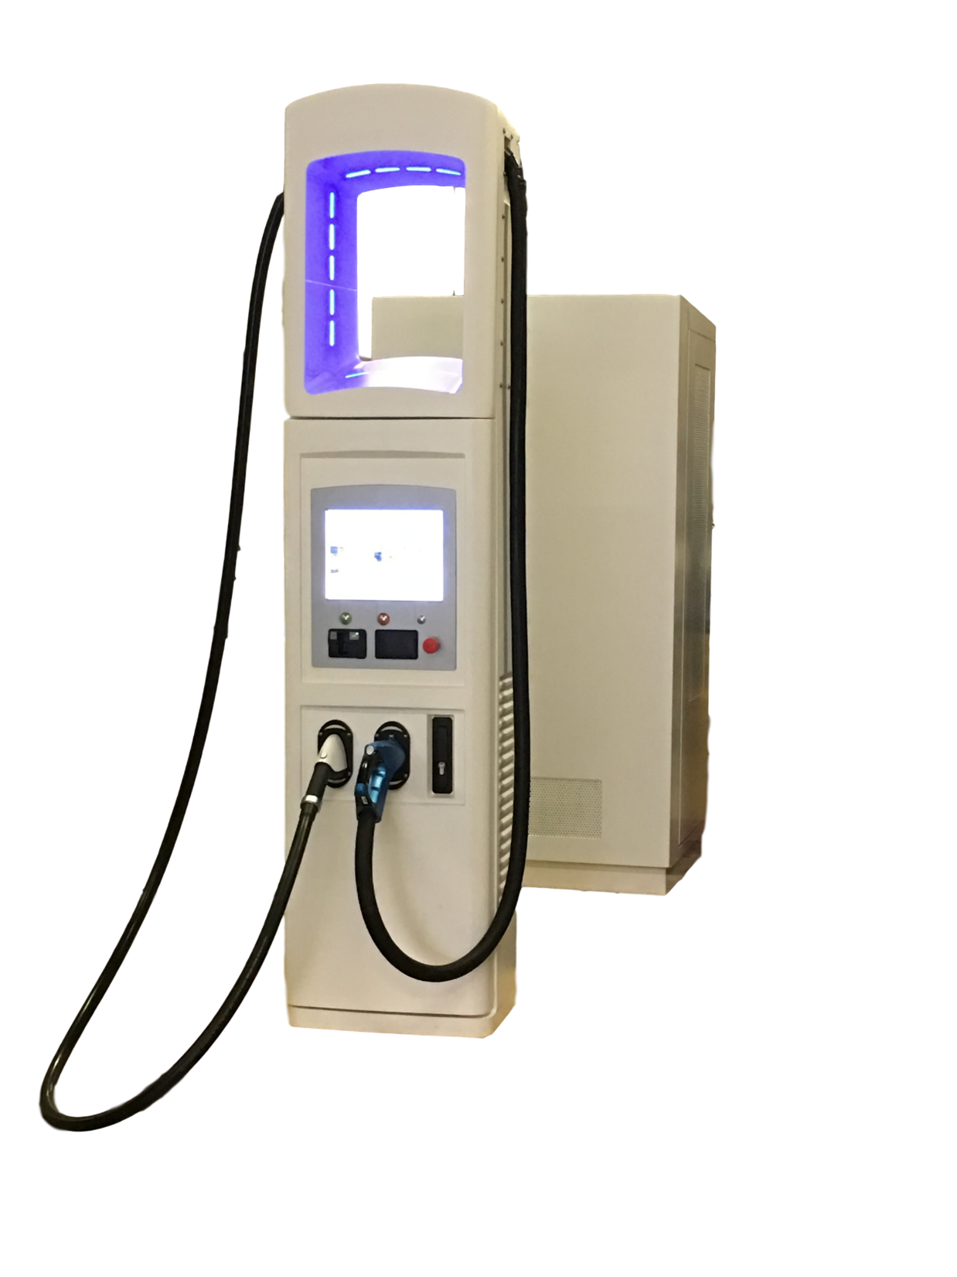

Slide 37
#8
Charging Station Infrastructure

Slide 39
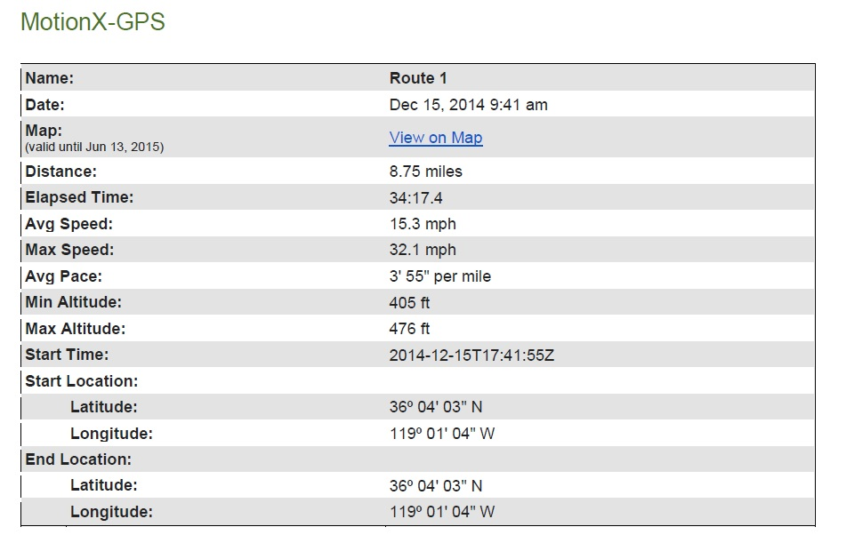
Infrastructure Planning
What type of service do you provide?
  Urban or Rural
  Daily Service Miles
  Existing Service Conditions

Slide 40
Infrastructure Planning
Utility
  Early Involvement in planning process
  Understand Rates and Low Carbon Fuel Credits
Electrical Engineering
  In-House vs Consultant
Technology
  Incremental Charging
  Charging Status and Communication

Slide 41
#9
Battery Management System

Slide 42
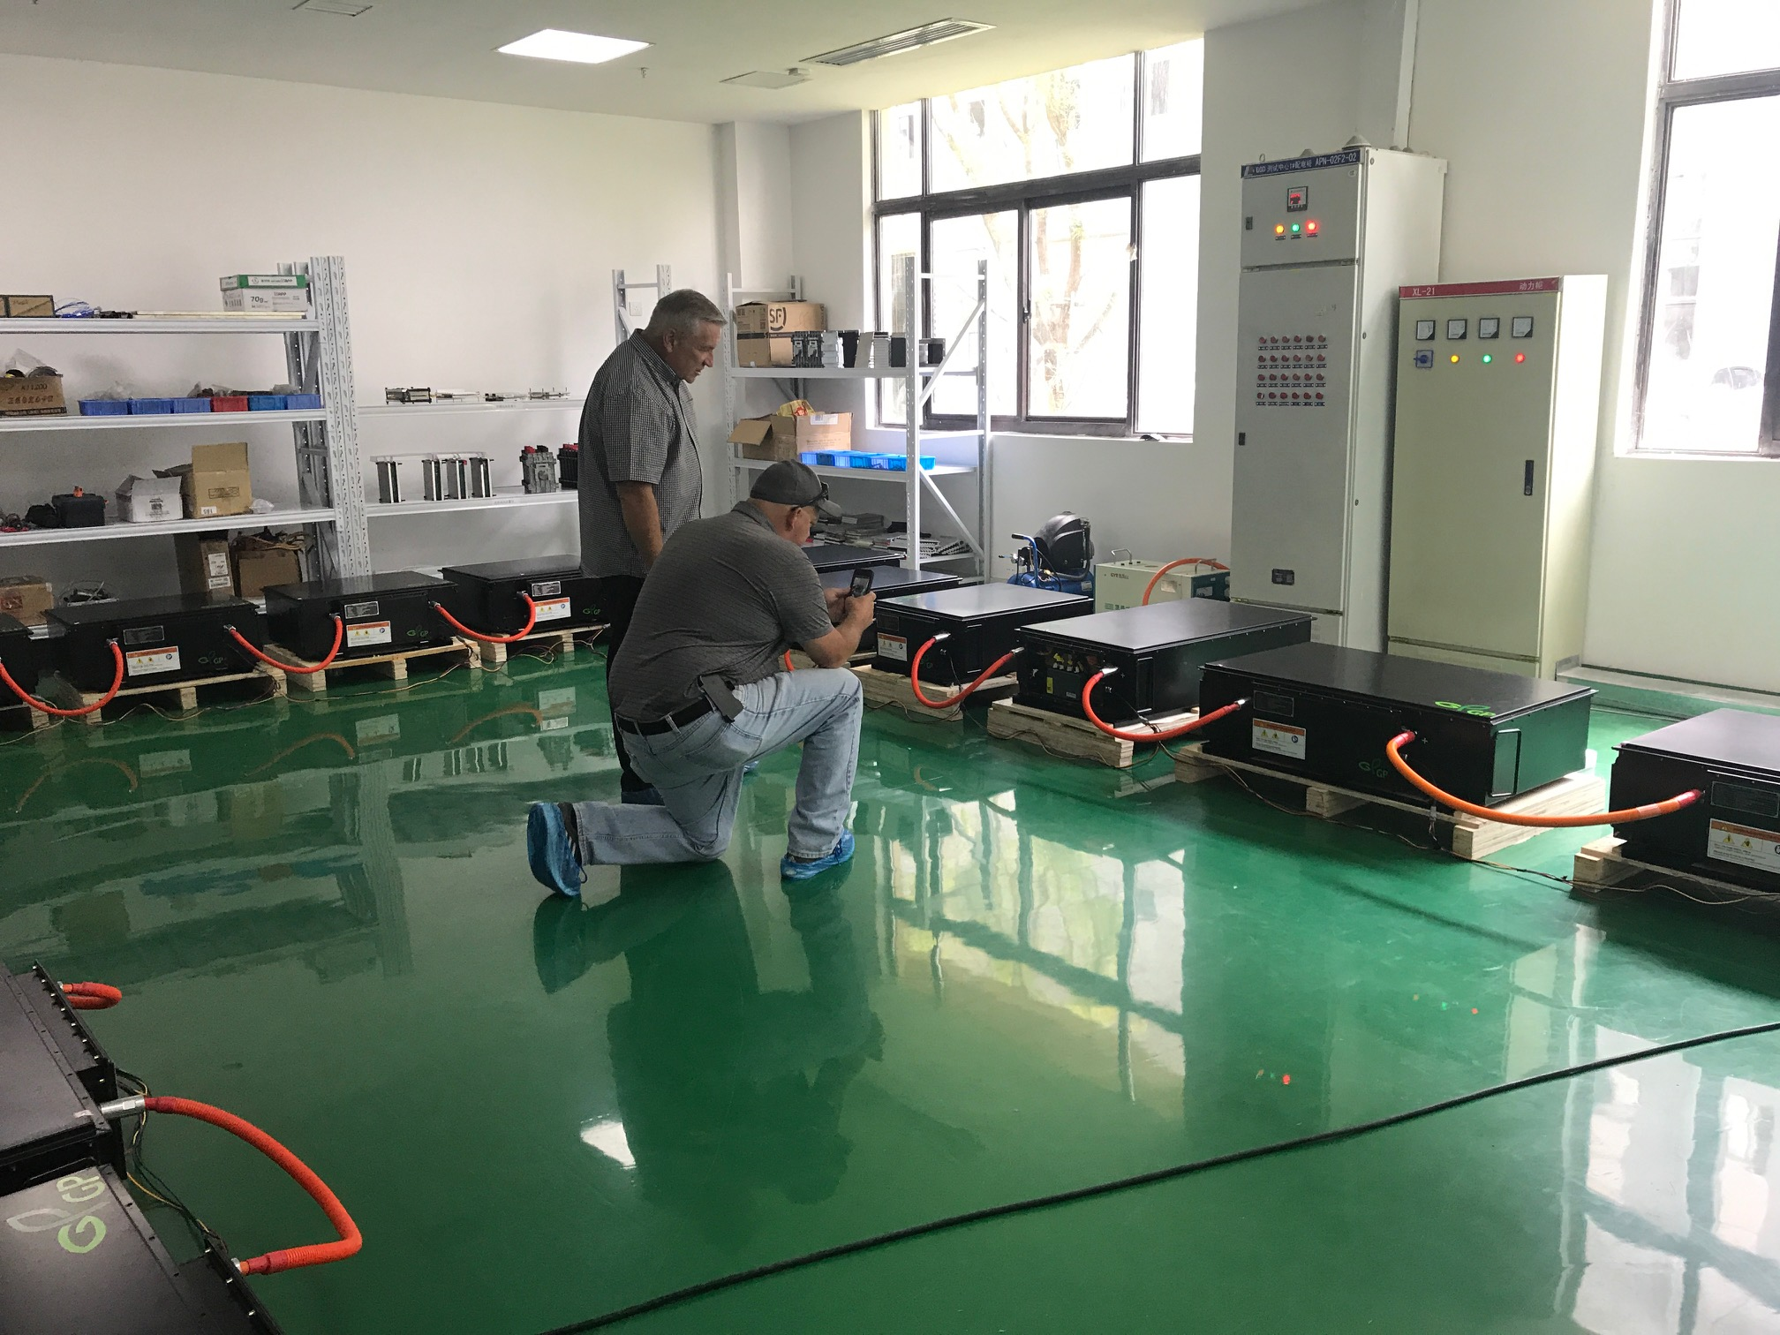

Slide 43
#10
BUCKLE UP!

Slide 44
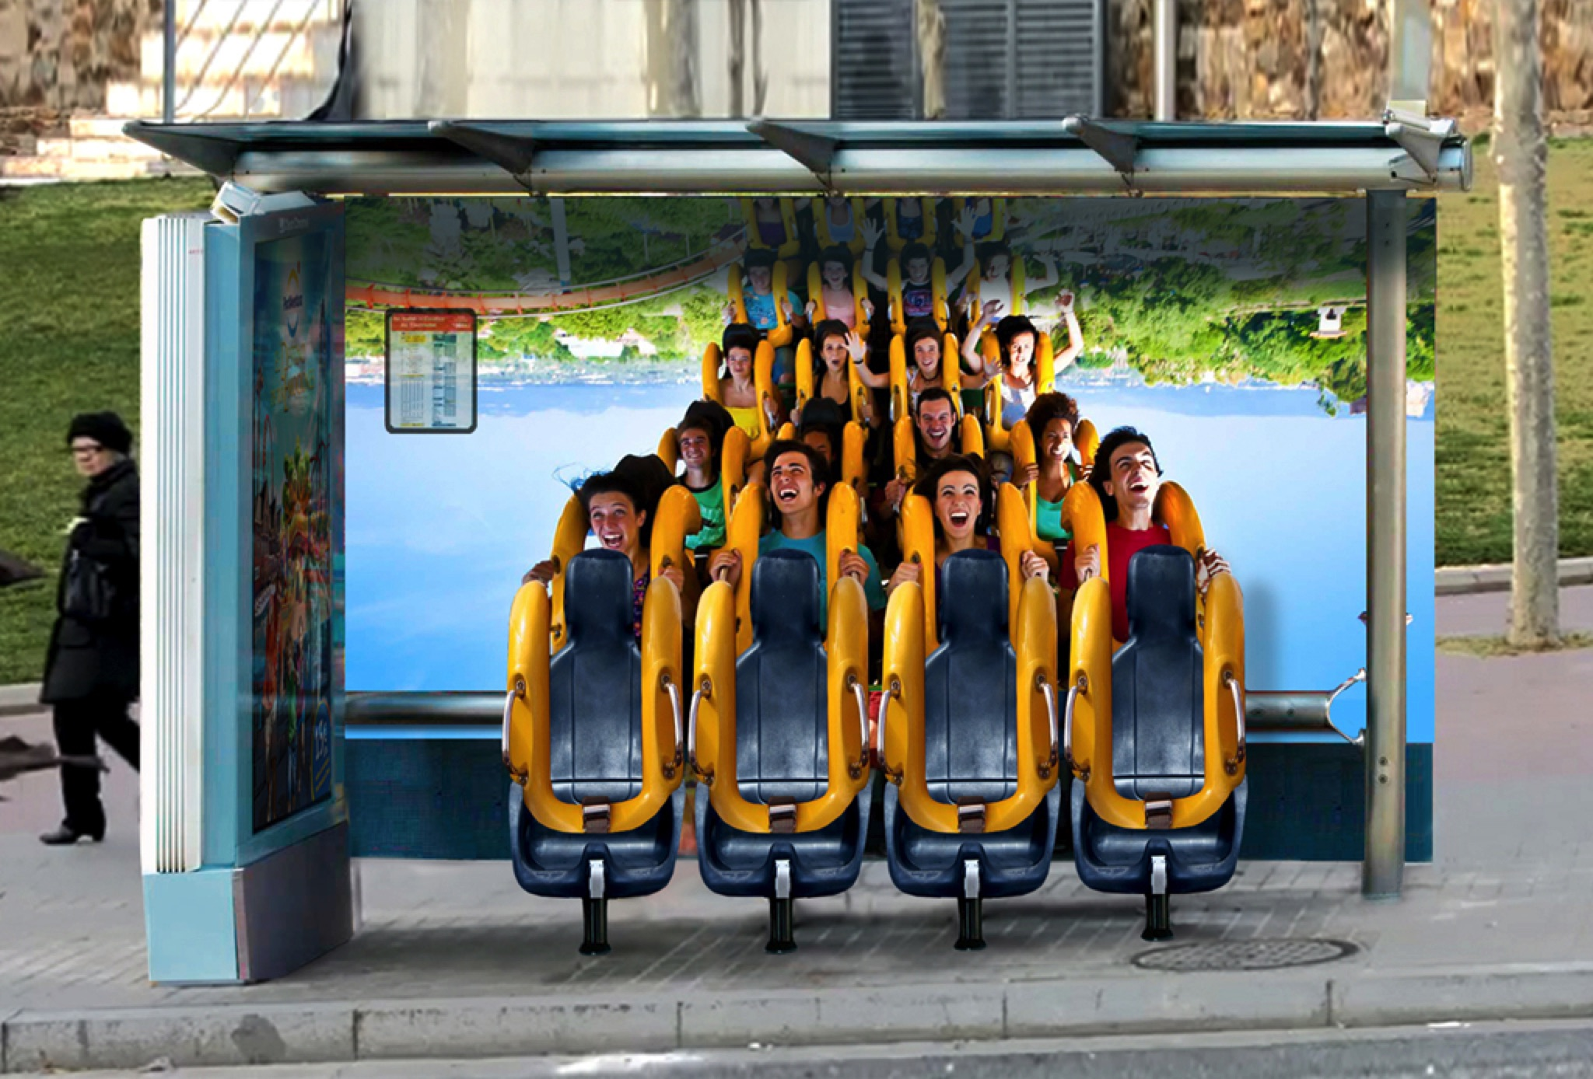
http://www.adeevee.com/2016/07/port-aventura-park-bus-stop-roller-coaster-media-outdoor/

Slide 45
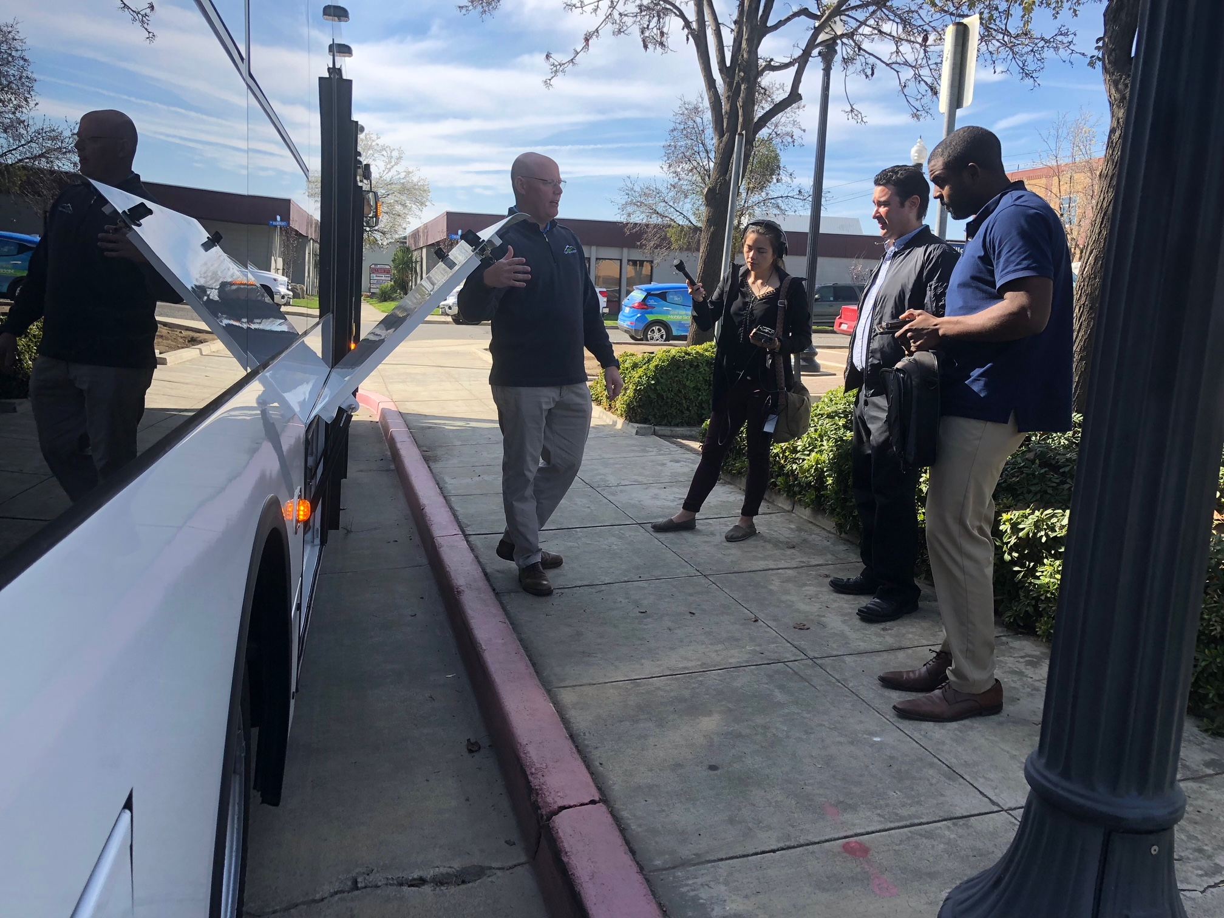
Share Your Success

Slide 46


Slide 47
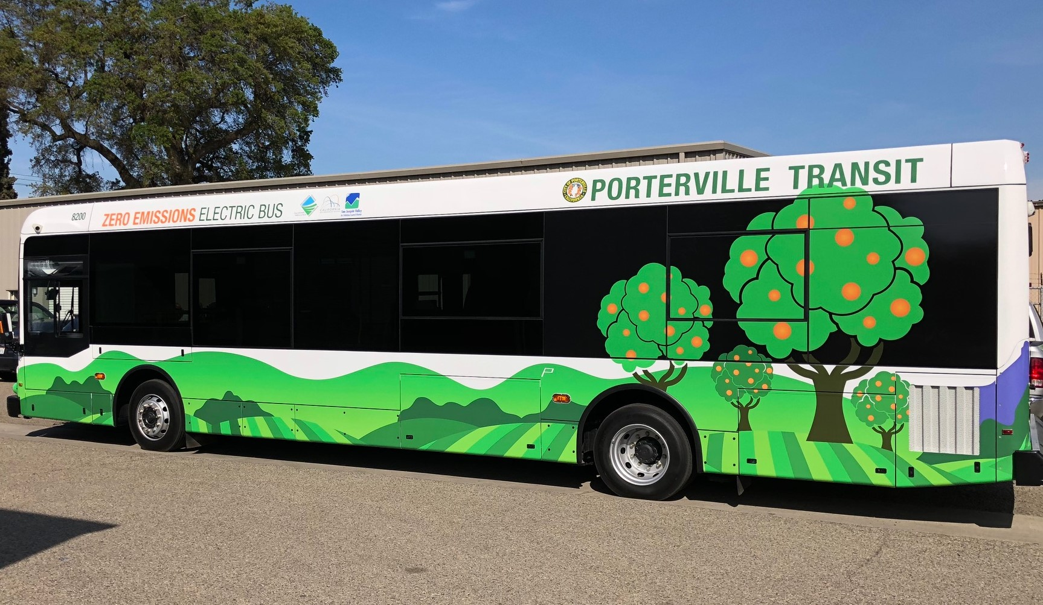

Slide 48
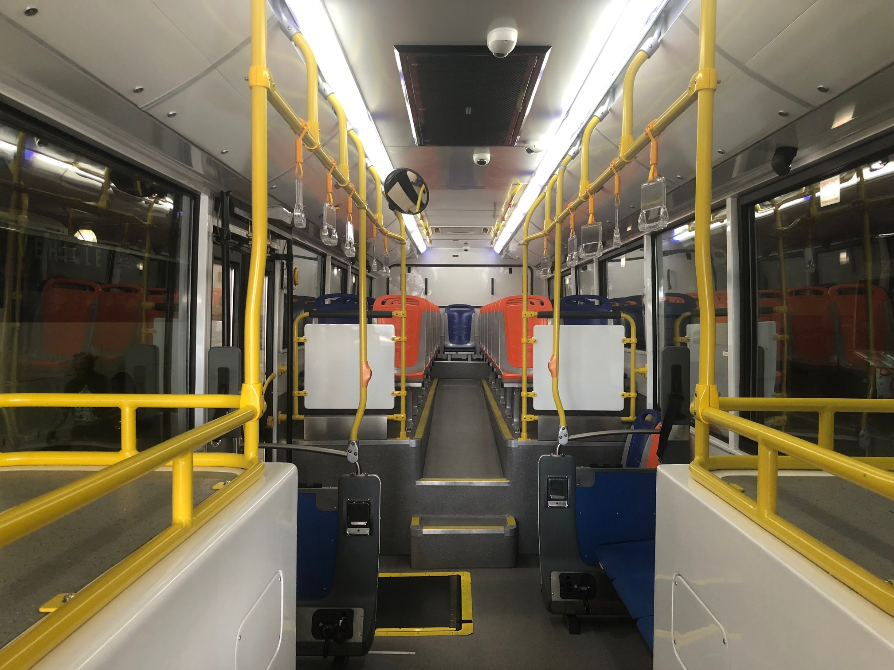

Slide 49
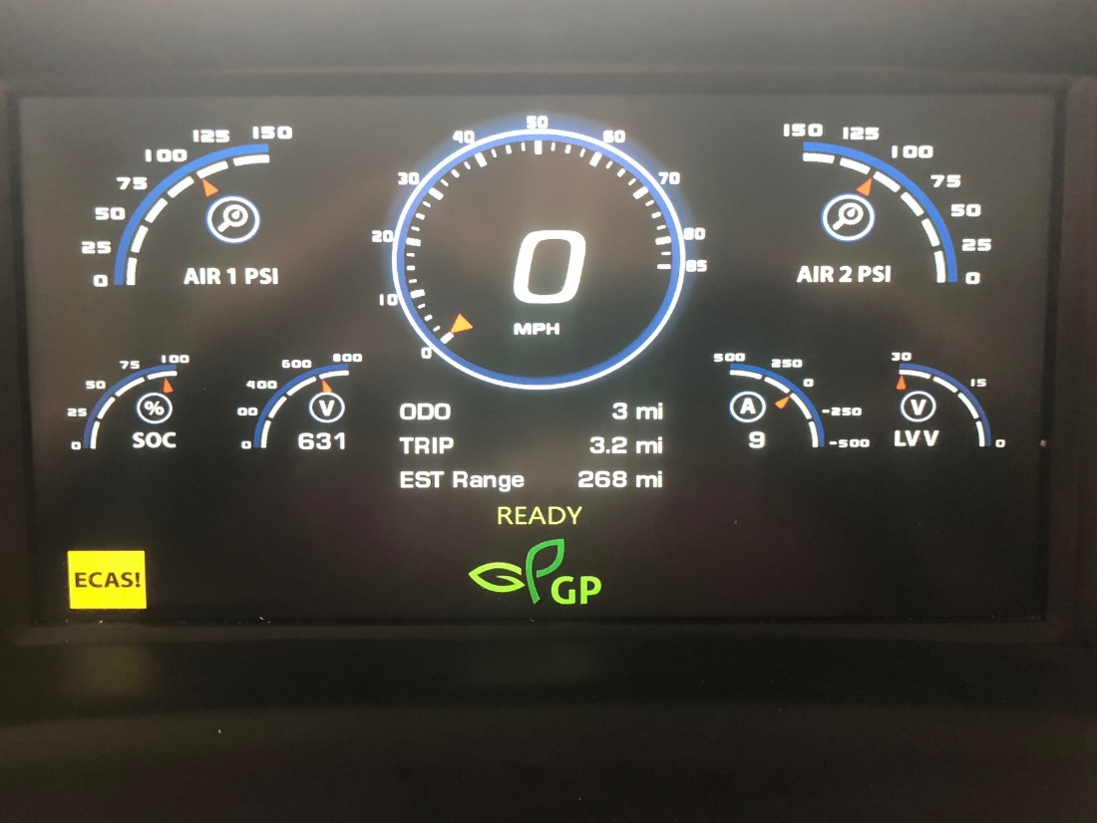
Fun Facts
GreenPower EV350 40 ft
430kW Battery Capacity
250+ miles on single charge
I/O Controls Digital Screen
RouteMatch Rider Engagement
Genfare Link Cloud Fare Management

