Slide 1
From #Metoo to #Wetoo
Creating Work Environments that Foster Accountability and Psychological Safety
May 16, 2018

Slide 2
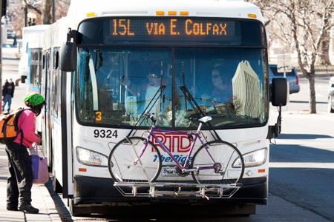
Agenda
Introductions
Why this topic matters
Types of harassment
Impact of harassment
Creating a psychologically safe work environment
Effective harassment management strategies
Wrap up

Slide 3
Discussion
Respectful Workplace
A respectful workplace is a place where…
Disrespectful Workplace
A workplace is not respectful when…

Slide 4
Connect the Dots
50%
Women reported
being
harassed
Did not
know their company’s harassment policies
27%
Women who experienced verbal harassment
88%
Match each statement about harassment with the correct percentage.
81%
Men who have been harassed
67%
Did not know who to go to after being harassed
21%
Harassed
by a
colleague
Source | 23 Statistics on Sexual Harassment, Brandon Gaille, 2017
Notes:
HANDOUT

Slide 5
From #Metoo to #Wetoo
Why is this topic important?
The numbers
The overt costs
Organization
Individual
Coworkers
The hidden costs

Slide 6
The Value of a Respectful Workplace
Employees spend 50% - 70% of their waking hours in the workplace. The quality of interpersonal interactions in the workplace has the potential to affect
Teamwork
Morale
Trust
Job Satisfaction

Slide 7
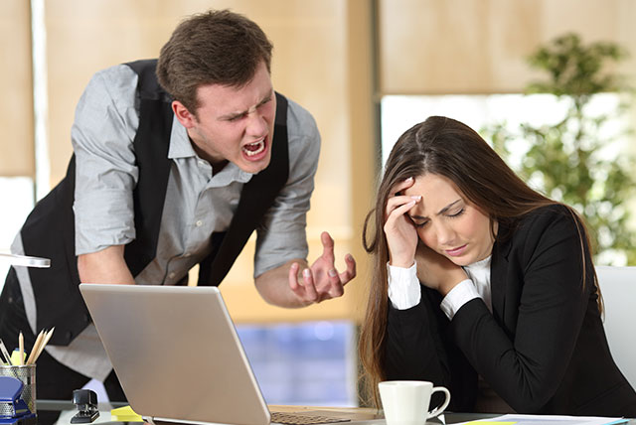
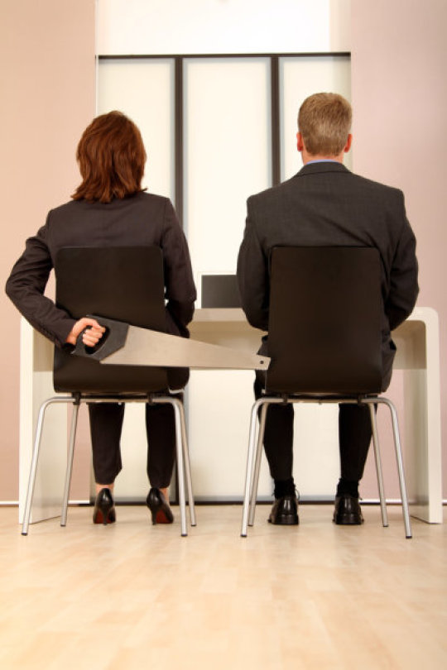
Types of Harassment
Discrimination Harassment
Sexual Harassment
Bullying Harassment
Incivility in the Workplace

Slide 8
EEOC Harassment Definition
Verbal or Physical conduct that denigrates or shows hostility or aversion toward an individual because of his or her race, color, religion, gender, national origin, age or disability, and that
has the purpose or effect of creating an intimidating, hostile or defensive work environment;
has the purpose or effect of unreasonably interfering with an individual’s work performance; or
otherwise adversely affects an individual’s employment opportunities.

Slide 9
Film Clip

Slide 10
Can Friendly Behavior Be Harassment?
Source | Academy of Management Journal, 1983| Kram

Slide 11
Is it Harassment?
Notes:
HANDOUT

Slide 12
Film Clip

Slide 13
What Does it Take to Cross the Line?
What is incivility in the workplace?

Slide 14
Workplace Bullying
According to the Workplace Bullying and Trauma Institute, workplace bullying is "the repeated mistreatment of one employee targeted by one or more employees with a malicious mix of humiliation, intimidation and sabotage of performance."
Statistics show that bullying is 3 times as prevalent as illegal discrimination and at least 1,600 times as prevalent as workplace violence
Statistics also show that while only one employee in every 10,000 becomes a victim of workplace violence, one in six experiences bullying at work
Bullying is also far more common than sexual harassment and verbal abuse

Slide 15
Top 10 Bullying Tactics
Accuse of errors
Stare, glare
Discount in meetings
Silent treatment
Supposed “mood swings”
Own rules
Disregard work
Criticize – different standard
Destructive rumors
Ganging up against

Slide 16
What is a Psychologically Safe Workplace?
Notes:
HANDOUT

Slide 17
Psychologically Safe Environment Discussion
Who is responsible?
What to do?

Slide 18
What Can a Leader Do?
Psychological support
Organizational culture
Clear leadership and expectations
Civility and respect
Growth and development
Recognition and reward
Involvement and influence
Workload management
Balance

Slide 19
Preventative Measures
Awareness
Policies and procedures
General HR Policies
Reporting procedures
Investigation procedures
No retribution policy
Roles and responsibilities
Co-workers
Supervisors and above
HR
Training
Role Modeling

Slide 20
Tips for a Diversified Workplace
Create an accepting climate
Confront limitations of stereotyping
Practice cultural awareness
Avoid slang names, ethnic jokes, and sarcasm
Speak clearly, paraphrase, and pay attention to your word choice
Ask about what you do not understand
Be aware and sensitive to your non-verbals

Slide 21
Tips for Avoiding Misunderstandings
Pay attention to people’s reactions
If you’re not sure – ASK
Be sensitive to diversity
Apologize and STOP
Provide support
Be assertive

Slide 22
Wrap Up and Questions

Slide 23
Thank you
Debi Lake dlake@envision-bc.com
Kelly Bolin kbolin@envision-bc.com
http://www.envision-bc.com

