Slide 1
Cultivating an Empowered Work Environment that Inspires and Engages Employees
May 16, 2018

Slide 2
Connect the Dots
62%
Feels
engaged
at work
32%
Feels their workplace
values them
22%
Has had a
mentor
Match each statement about workforce engagement with the correct percentage.
Feels their workplace
promotes
work/life balance
13%
21%
Actively
looking for
another job
52%
Taken a
sick day due
to stress on
the job
Source │2017 Employee Engagement and Retention Statistics, Brandon Carter
Notes:
HANDOUT

Slide 3
A Look At The Numbers
84% of Americans are unhappy with their current job. Source │ CNN Money
1 in 3 US Employees are serious about leaving their current jobs. Source │ Mercer’s What’s Working Survey
Employees are the unhappiest they’ve been in their 22 years of tracking job satisfaction.
Source │ Conference Board

Slide 4
Business Case for Happiness at Work
Employees who score low in “life satisfaction”
stay home an average of 1.25 more days a month.
Source │ Gallup Healthways
Health related work losses are estimated to cost US employers more than $450 billion each year.
Source │2017 Employee Engagement and Retention Statistics, Brandon Carter

Slide 5
A Decade of Research Has Proven
Happiness raises nearly every business
and educational outcome.

Slide 6
Check Out These Numbers
36% of employees would give up $5,000 a year in salary to be happier at work
People with a best friend at work are 7X more likely to engage fully in their work
Close work friendships boost employee satisfaction by 50%
Companies with happier employees outperform their competition by 20%
67% of full time employees with access to free food are “extremely happy at their current job”
Source|Snacknation.com, 2018

Slide 7
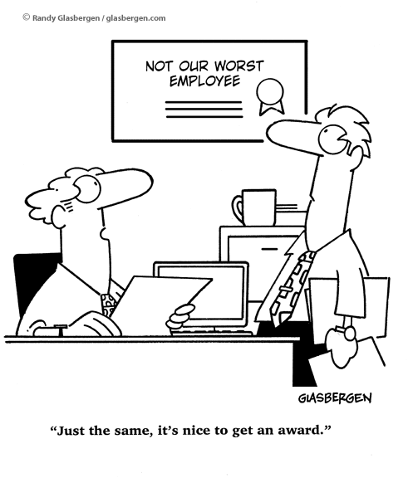
What Motivates Us?
Intrinsic
Versus
Extrinsic
Motivation

Slide 8
Just How Much am I in Control?
Source │ WebMD
Notes:
HANDOUT

Slide 9
Flourishing Individuals Profile
Contributors
Interested
Energetic
Feel valued, respected, and appreciated
Experience their work as having purpose and meaning

Slide 10
Benefits: Physical, Mental and Social
Physical: Boost immunity, lower stress hormone, decreases pain, relaxes muscles, prevents heart disease, lowers blood pressure, healthier blood fat profiles
Mental: Adds joy and zest to life, eases anxiety and fear, relieves stress, improves mood, enhances resilience
Social: Strengthens relationships, attracts others to us, enhances team work, helps diffuse conflict, promotes group bonding
Sources │ HelpGuide.org, Psychological Bulletin

Slide 11
Happiness is Being Socially Connected
Quantity and Quality of Social Connections
=
Well-being and Personal Happiness
Source │ Greater Good Berkeley

Slide 12
Happiness Table Topics
Research shows that people who have a sense of connection with others are happier!

Slide 13
What Is A Flourishing Organization?
Is concerned with conditions that foster thriving at the individual, work group, and organizational levels
Has a focus on the development of strengths or capabilities
Has an emphasis on the generative, life-giving dynamics of the organization

Slide 14
Flourishing Organizations Blueprint
Engagement
Sustainability
Leadership
Diversity
Employees with full, balanced lives
Connections to causes that matter
Products and services that meet real community needs
Most of all, flourishing requires coordinated, other-aware participation,
from all of us who are advocates and agents of organizational change.

Slide 15
How Do You Flourish?

Slide 16
Stop / Start / Continue

Slide 17
Take the Challenge!
Be happier and engaged!

Slide 18
Thank you
Debi Lake dlake@envision-bc.com
Kelly Bolin kbolin@envision-bc.com
http://www.envision-bc.com

