Slide 1
CASTA Fall Conference Grant Partner Session

Slide 2
Welcome
Introductions
Agenda Overview
Thank you

Slide 3
Agenda
Grants & Grant Partner Topics
Bus Operations and “Outrider” Topics
Planning Related Topics
SB 267 Discussion
Adjourn

Slide 5
Grants & Grantees Topics

Slide 7
Grants By the Numbers
- 185 Days

Slide 8
Grants By the Numbers
- 100 Days

Slide 9
Grants By the Numbers

Slide 10
Grants By the Numbers
- 59 Days

Slide 11
Grants By the Numbers

Slide 12
Grants By the Numbers

Slide 13
Grants By the Numbers

Slide 14
Grants By the Numbers

Slide 15
Grants By the Numbers

Slide 16
Grants By the Numbers

Slide 20
Reimbursements
Submit eligible and allowable costs
2 CFR 200.420-475
FTA C 5010.1E Chapter VI – Grants Management
FTA C 9040.1G – 5311
“At a minimum, states must consider the following items as operating expenses: fuel, oil, drivers’ salaries and fringe benefits, dispatcher salaries and fringe benefits, and licenses.”

Slide 21
2017 Grantee Oversight
18 Different Grantees to Review
8 Reviews Completed
10 Reviews to Go
Using the GIR (Grantee Information Request)
Desk Review
Site View
Follow Up – Training, Templates, Guidance
Opportunity to improve Best Management Practices

Slide 22
2018 State Management Review
FY 2018 SMR – GIR to arrive in Oct/Nov
Since March – Answering GIR questions
17 Sections, Answered over 400 Questions
FTA moving to – “Source Documents”
Gathering “known” source documents
FTA will requests to conduct reviews on two grantees

Slide 23
State Management Plan
Changes
Oversight
5311 Approach
Mobility Management
Updates
Public Involvement and Review
Ideal Schedule of Update
Ready for final public input and review by Town Halls

Slide 24
DTR Annual Budget
Transit Expenditure Area, Regardless of Funding Source | Budget (Millions)
Local Capital: Vehicles, Equipment, Buildings, Facilities | $17.0
Local Operating, Coordinating Councils, Mobility Management | $7.5
Intercity 5311(f), Bustang, & FASTER Regional Operating | $5.5
Administration, Compliance, RTAP, 5304 Planning, Tech Assistance | $2.5
Total | $32.5

Slide 25
Transit Program Delivery
State
$5.5 M
17%
Shared
$2.5 M
8%
Delivery of Project or Service
$24.5 M
75%
Local
Local
Shared
State
Influence on Decisions

Slide 26
Transit Program Delivery
State
CDOT Park
& Ride
State
Transit Plan
Bustang
Shared
FASTER
Operating
5311(f) &
Outrider
Mitigation
& CSS
Delivery of Project or Service
5310
5311
FASTER Local
Shared
Park &
Ride
5304
Planning
Local
Local
Shared
State
Influence on Decisions

Slide 27
Bustang & Bustang Outrider Update

Slide 28
Planned Bustang 2018 Service Enhancements
Add Glenwood to Denver “Seasonal” Service
1 roundtrip/day; Dec 15 - Easter
Add Grand Junction to Denver
1 roundtrip/day
Convert current Greyhound route to Bustang
Add Denver to Raton NM
Adds 1 roundtrip Denver to Colorado Springs
Extends Bustang to Trinidad & Pueblo

Slide 29
2018 Intercity, Bustang, and Outrider System Map

Slide 30
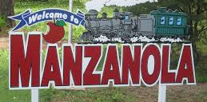
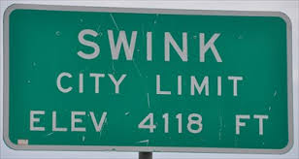
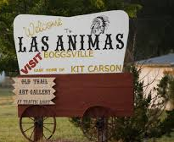
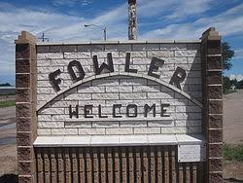
Bustang Outrider
Unified branding
Locally delivered
Partnerships
Customer service

Slide 31
Questions & Answers

Slide 32
Planning Related Topics

Slide 33
Transit Development Program

Slide 34
Asset Management Plan

Slide 35
5311 Redistribution: What is the Effort?
Two-year effort to create new policy on how CDOT distributes FTA Section 5311 operating funds
Needed because:
Slow or no growth in federal funding
New agencies are requesting funding
Limited transparency in old methodology

Slide 36
What Has Occurred?
5311 Subcommittee formed in October 2016
New methodology for distributing funds approved in April 2017
One-year approval by CDOT Transportation Commission
Methodology was used to determine grant levels for 2018

Slide 37
What is the Methodology?
Categorize grantees into five peer groups
Based on expenses, miles, hours, trips
Assign a budget factor to each category:
Very Small: 50%
Small: 45%
Medium: 21%
Large: 14%
Extra Large: 4%

Slide 38
What is the Methodology? (cont)
3. Keep some grantees whole or allow a higher percentage of funding
4. Allow for gradual increases and decreases from previous year award
Decreases of 3%, 3%, 5%, 6%, and 7%

Slide 39
What’s Next?
Subcommittee will continue to meet
Explore concerns raised by CDOT Transportation Commission
Evaluating other scenarios
Plan to finalize methodology in time for 2019 awards

Slide 40
Grant Opportunities
Upcoming Notice of Funding Availabilities (NOFAs) for planning and capital projects
FTA 5339 opportunities
Volkswagen funds

Slide 41
Upcoming NOFAs
NOFA for planning projects
FTA 5304 funds
Examples of projects include:
Transit operating plans
Other planning effort
Research
Demonstration projects
Past projects include feasibility studies, transit plan updates, improved marketing opps, coordination studies, etc
FASTER planning money available for pre-construction work (NEPA, design), but awarded during capital call

Slide 42
Upcoming NOFAs
NOFA for capital projects
FTA 5310, 5311, 5339, FASTER
Available in October, closing six weeks later
Examples of projects include:
Vehicles
Facilities (park and rides, maintenance buildings)
Pre-construction (NEPA, design)

Slide 43
Section 5339
Nationwide, competitive programs
Low or No Emission Vehicle ($55 million)
AWARDED $1.45 Million!!
Bus and Bus Facilities ($227 million)
CDOT submits a consolidated application on behalf of rural agencies
CDOT and CASTA paid for consultant to help review applications
Excellent opportunity to improve grant writing

Slide 44
Section 5339
Will you apply next year?
Introduce/expand electric vehicles?
Backlog of old vehicles?
Facility needs?

Slide 45
Volkswagen Settlement
VW has agreed to settle allegations it cheated on federal emission tests
Colorado expects to receive $68.7 million
Colorado Dept of Public Health and Environment (CDPHE) designated as the state’s lead agency
CDPHE partnered with CDOT and others to develop a spending plan known as the Beneficiary Mitigation Plan

Slide 46
Volkswagen Settlement
Draft BMP has five funding categories:
$10.3 M (15%) for electric vehicle charging infrastructure
$18 M (26%) for alt fuel vehicles
$18 M (26%) for alt fuel transit buses
$5 M (7%) for non-road diesel engines or equipment
$12.2 M (18%) million reserve fund

Slide 47
Volkswagen Settlement
Comments on draft BMP will be accepted until October 13th
Funding will be become part of annual capital NOFA (likely fall 2018)
GREAT OPPORTUNITY TO INTRODUCE ALT FUEL VEHICLES TO YOUR FLEET

Slide 48
State Safety Oversight (SSO)
Under MAP-21, states assume greater responsibility for overseeing the safety of their rail systems
FTA is responsible to review and approve each state’s SSO program
By April 15, 2019, each state must have a certified SSO program
No SSO certification means no FTA funding for the state
Colorado Public Utilities Commission has responsibility for safety and security of rail systems in the state

Slide 49
State Safety Oversight (SSO)

Slide 50
State Safety Oversight
PUC has currently submitted all documentation for review except revised Program Standard
Program Standard to be submitted to FTA by January 2018
Goal is to submit certification application by April 2018

Slide 51
Questions & Answers

Slide 52
SB 267 & Possible Reprogramming of Annual Transit Funds

Slide 53
Reprogramming Transit Funds
5311 process brought focus to divergent transit needs
Mountain versus Resort versus More Rural Communities
Demand Response versus Fixed Route Transit Systems
Local abilities to fund transit needs
What is Fair and Equitable?
Human Service trips have top priority - Agreed
Service Sector employee commute trips important
Congestion reduction important
More Operating Funds Needed
Must be sustainable
FTA funding increases not keeping pace with operating costs
Nat’l Ave State Funding 23% / Colorado 1%
Minimum Wage to exacerbate problem

Slide 54
Reprogramming Transit Funds
Rural Transit Funding Stream
Sustainable – FTA & FASTER Transit
Periodic – e.g. SB 228 & SB 267
Current Uses
Operating – FTA funds
Capital – FTA and FASTER Transit

Slide 55
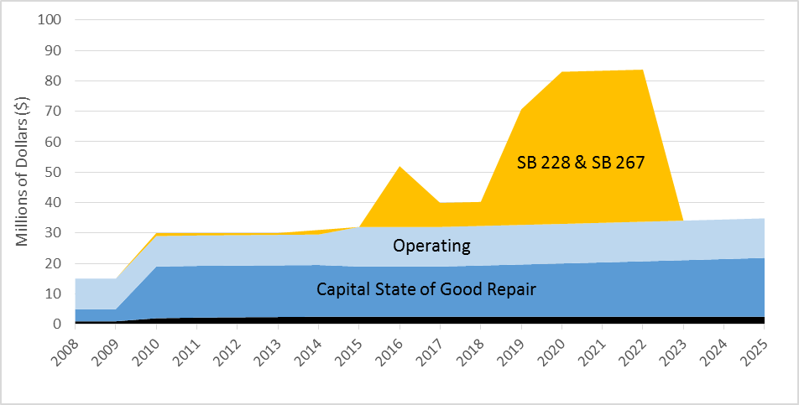
Existing Funds & Uses

Slide 56
Reprogramming Transit Funds
Possible Scenario
Utilize sustainable FASTER Transit for operating funds
Use FASTER Local funds to increase Local Operating Pool
$2.0M/year, 25% increase to local operating pool
Reduces local match, emphasis on most rural communities
Use FASTER Statewide funds to increase Interregional and Rural Reg Pools
$0.5M/year for Bustang, 16% increase for service expansion
$1.5M/year for Outrider, 88% increase for new routes or local assistance
Utilize periodic State funds to backfill capital needs
Use SB 228 funds for Local Capital Pool
$10.0M at $2.0M/year for 5 years
Use SB 267 funds for larger facilities
Park and Rides, transit centers, maintenance facilities, BRT facilities, etc
Commit future periodic State funds to Local Capital Pool

Slide 57
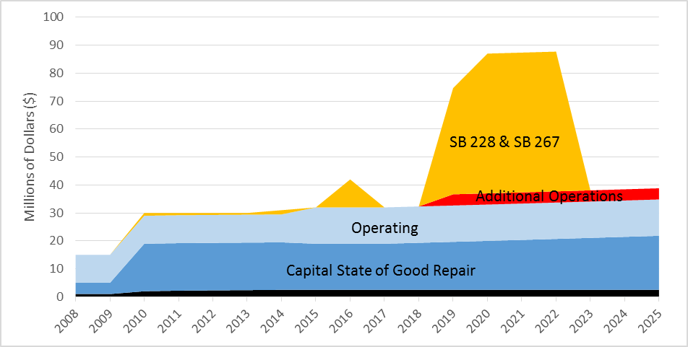
Figure 2: Possible Reprogramming of Funds and Uses

Slide 58
Questions & Answers

Slide 59
Adjourn Thank you & Safe Travels

Slide 60
healthy
Notes:
NOTES
JBC Members:
Sen Lambert= Chair
Rep Hamner = Vice Chair
Sen Moreno = US36, I25, 270, 76, and very close to central I-70 viaduct project, was a Rep and now a freshman Senator
Sen Lambert = South I-25 including Air Force Academy, Monument hill, senior Republican on committee
Sen Lundberg = N I-25 Loveland to the state line without the stretch by Fort Collins, newly appointed to JBC
Rep Hamner, Rep Rankin = I-70 into the mountains (Hamner = Summit county, and Rankin = Garfield, Moffat and Rio Blanco counties),
Rep Young = our House sponsor for Primary Seatbelt bill
CDOT’s goal is to be the best DOT in the country.
How we get there is by focusing on our customers and by integrating new, creative approaches into how we have traditionally done business.

