Slide 1
CASTA May 17, 2017
DAVE GENOVA GM & CEO
REGIONAL TRANSPORTATION DISTRICT Denver, Colorado

Slide 2
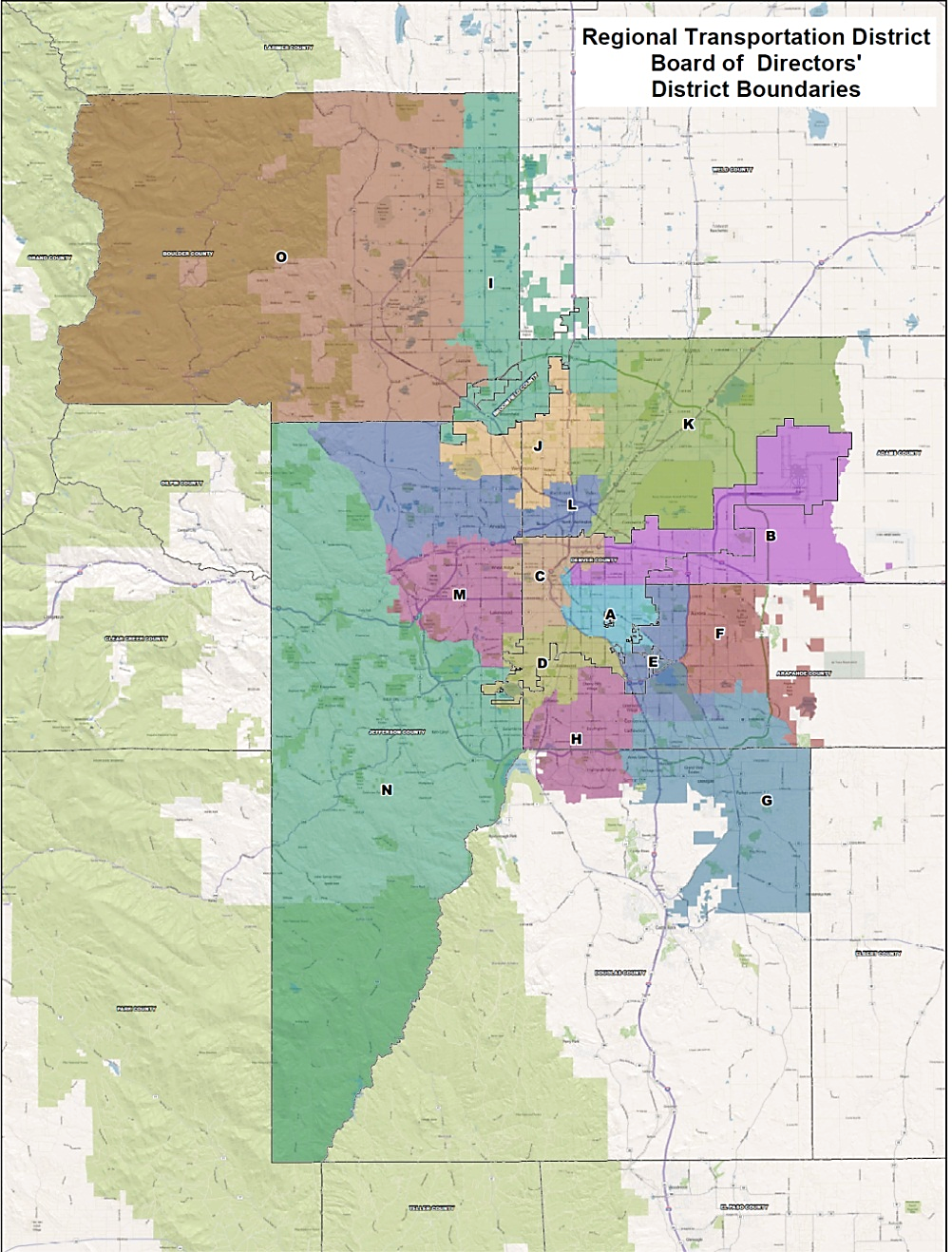
RTD Overview
Created in 1969
Eight-county service area
Service area: 2,342 sq. miles
2.92 million population
15 elected Board members
1 percent sales tax
0.6% base system
0.4% FasTracks
2,813 employees
2

Slide 3
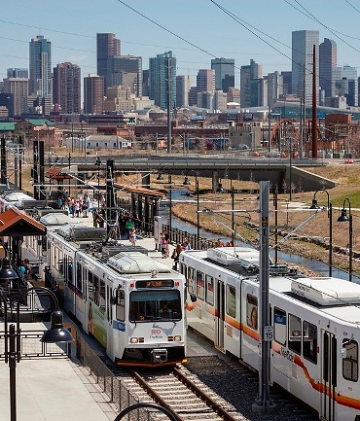
RTD Overview (cont.)
1,023 buses
172 light rail vehicles
66 commuter rail vehicles
80 park-n-Rides/31,000 parking spaces
58.5 miles of light rail
62 light rail stations
100 million annual boardings
3

Slide 4
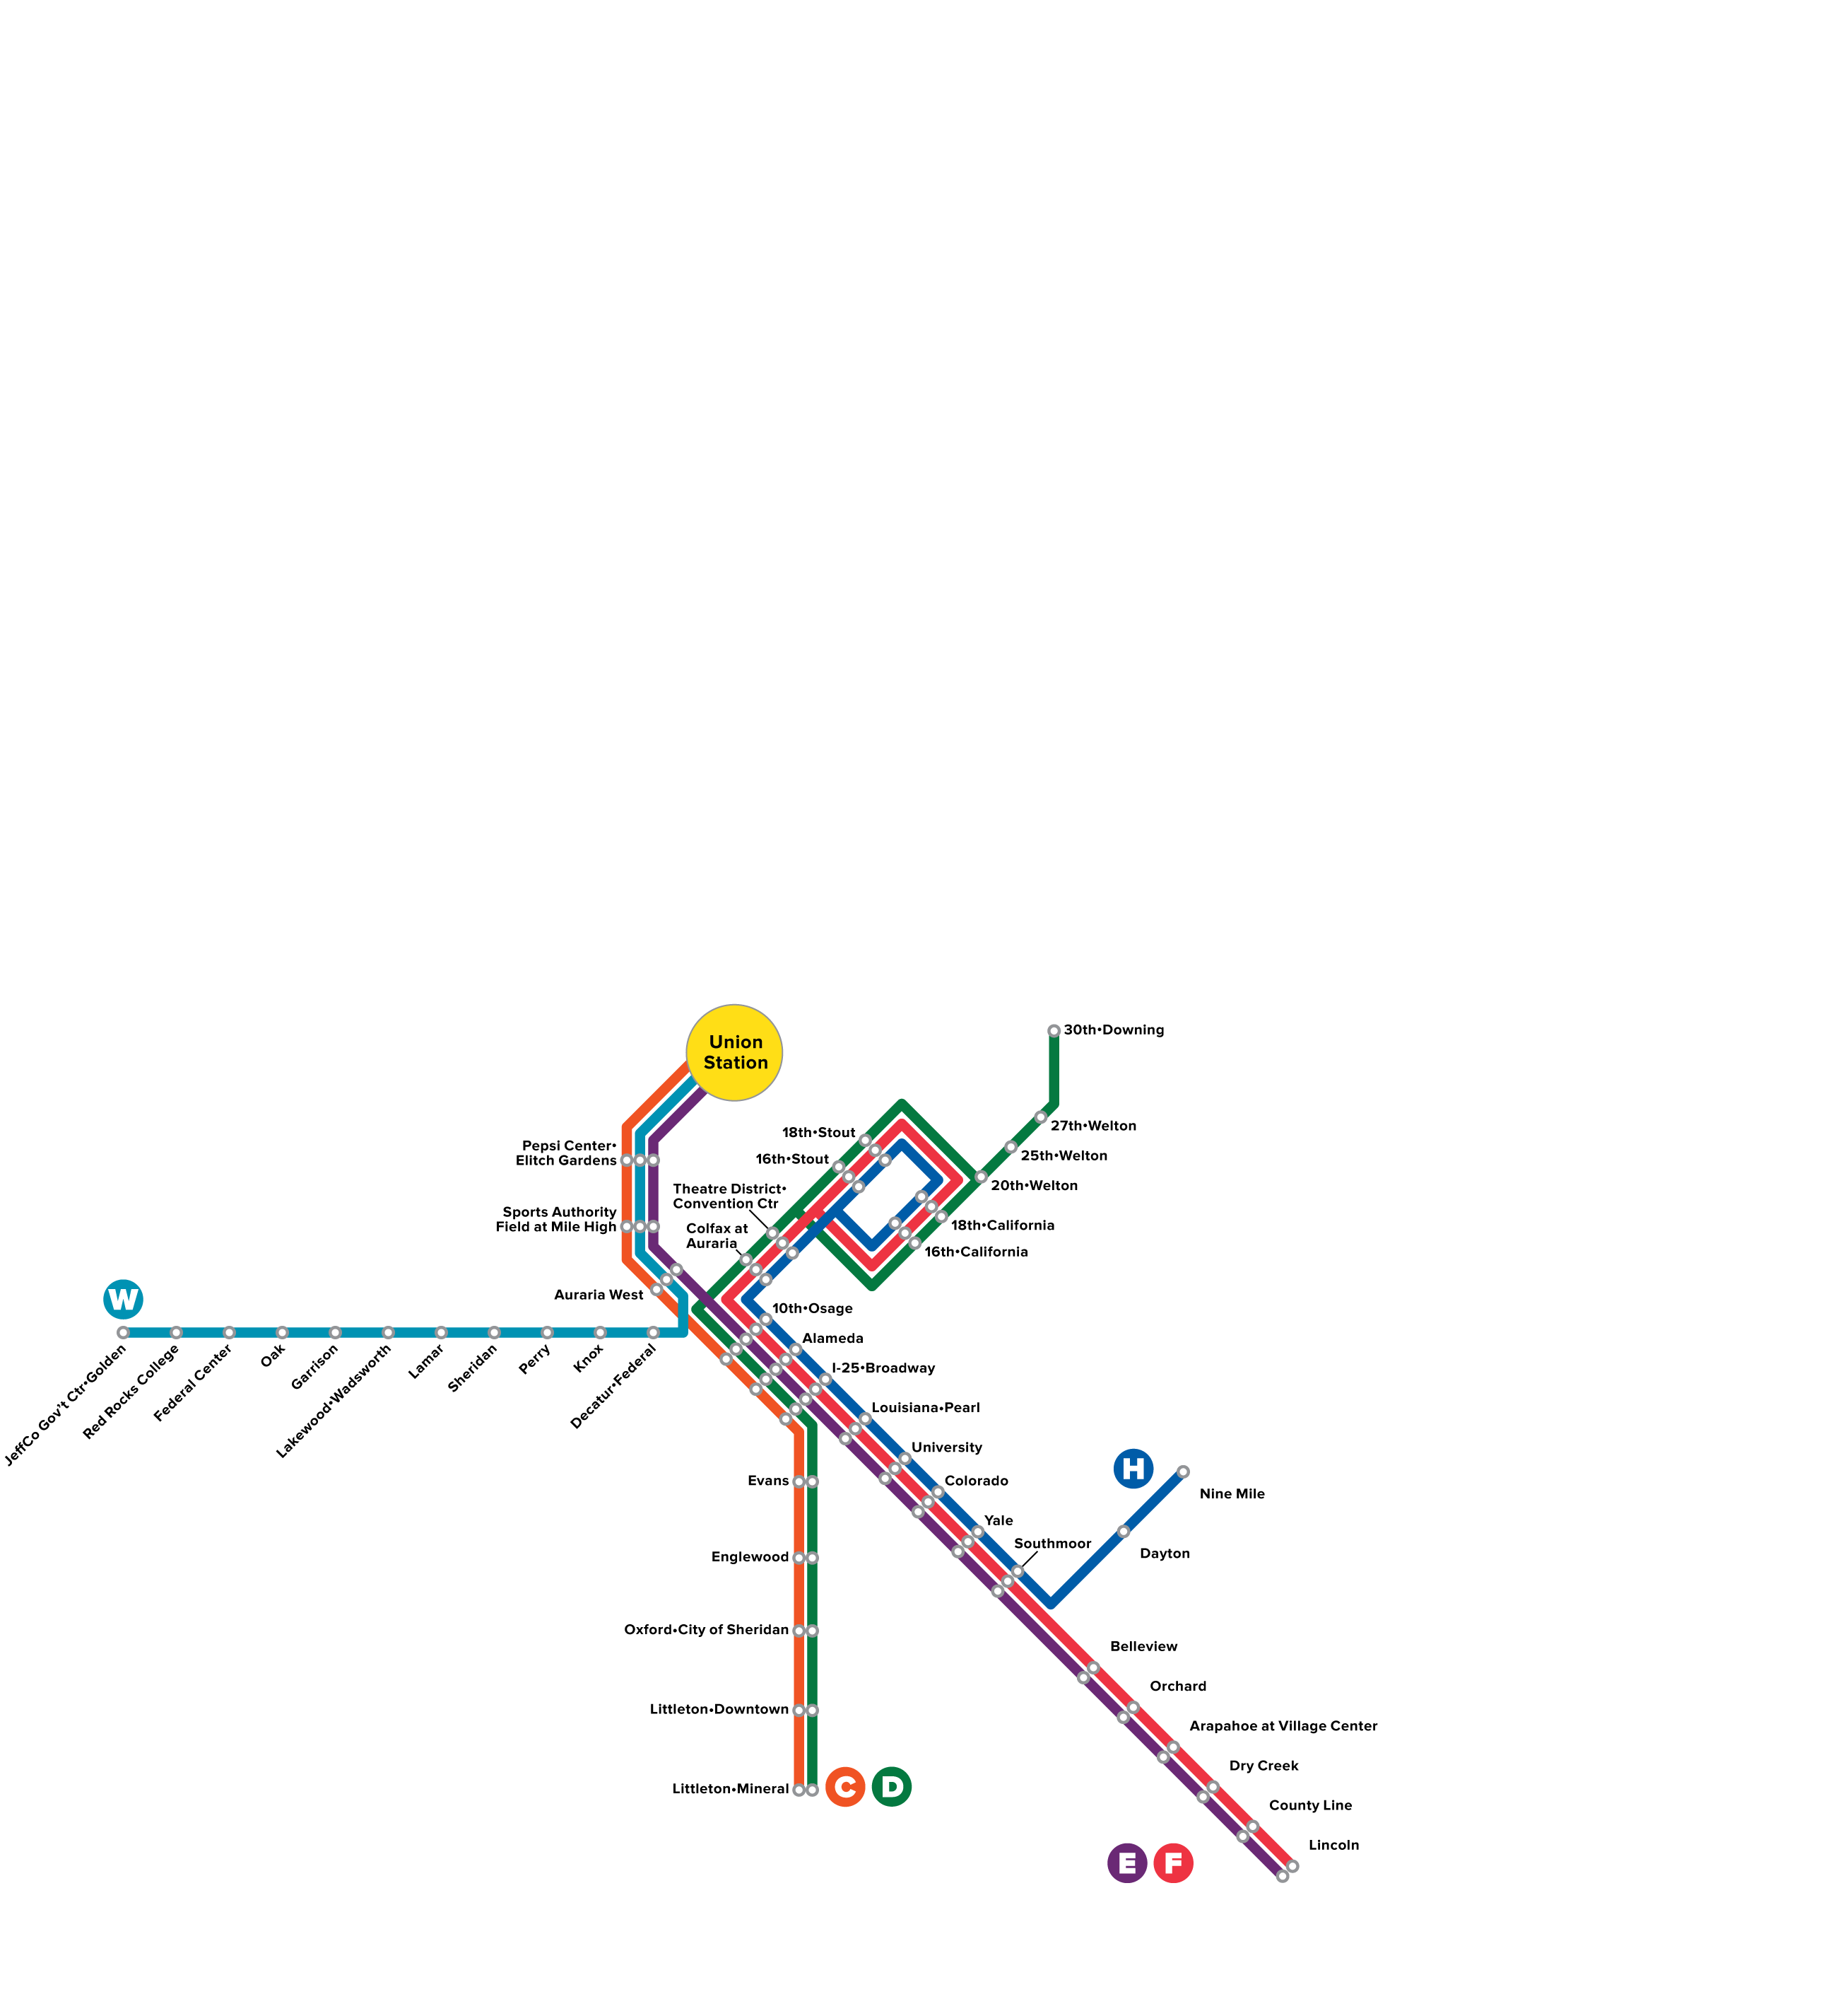
W Line 2013

Slide 5
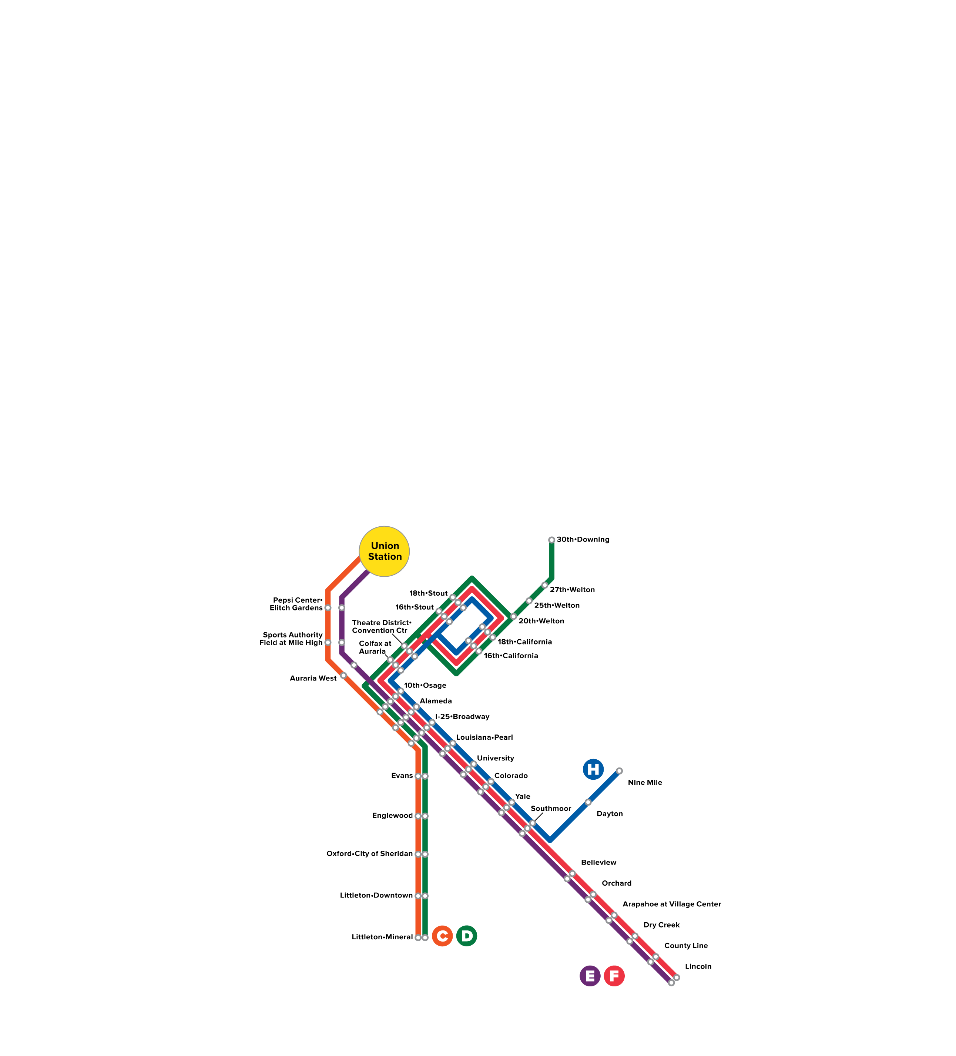
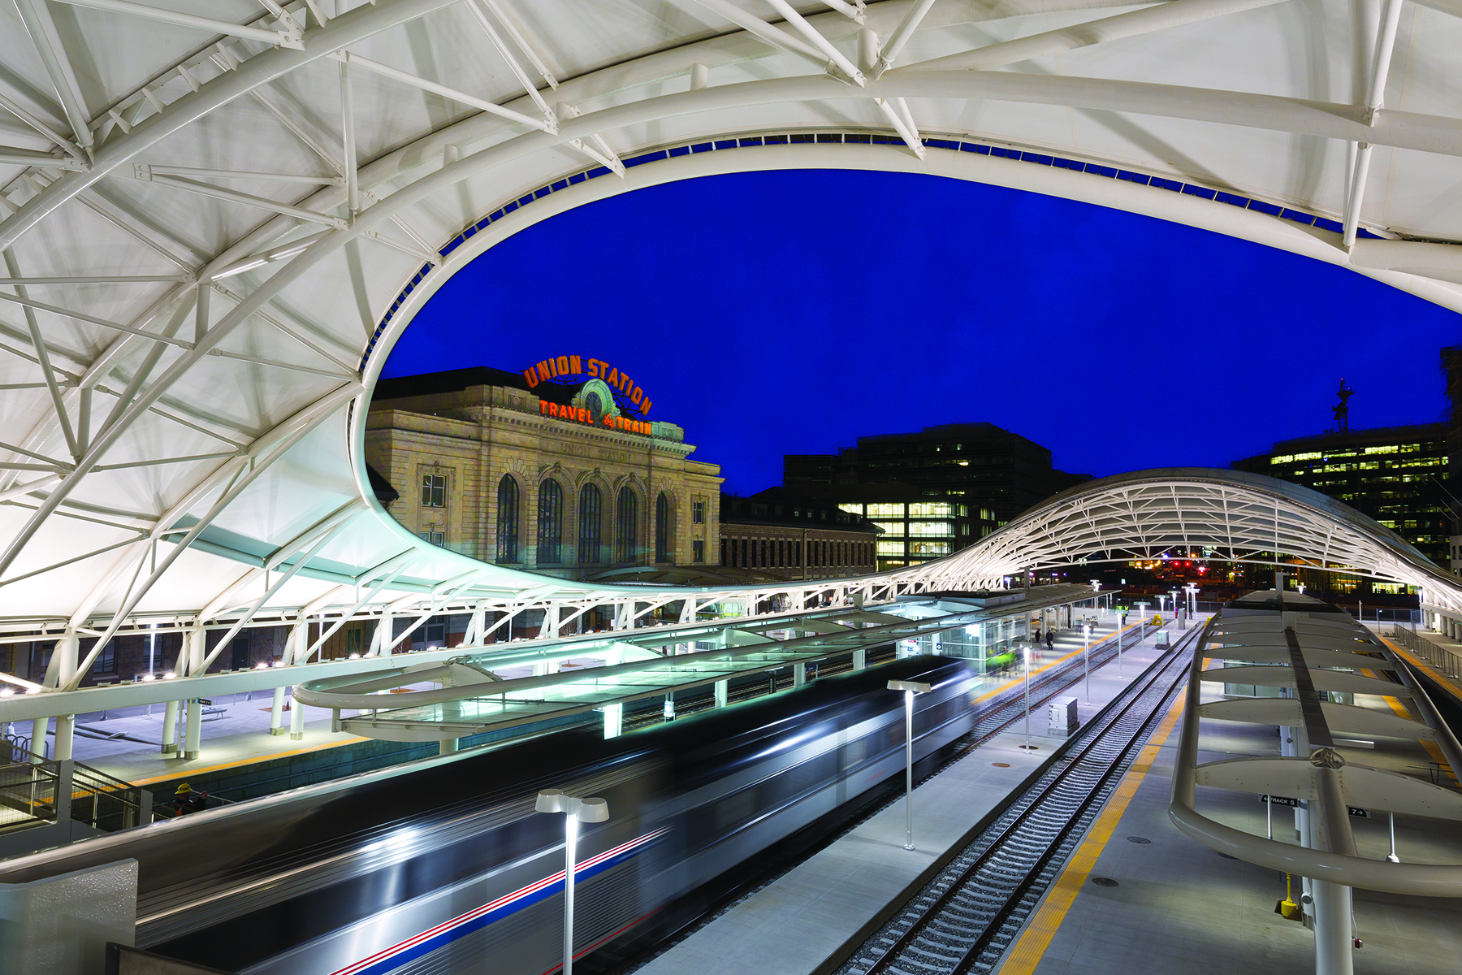
Union Station 2014

Slide 6
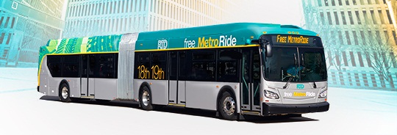
Free MetroRide
Additional transit capacity between DUS and Civic Center
Free service complements Free MallRide service; runs along 18th and 19th streets
Stops two to three blocks apart for faster travel than MallRide
Service began May 2014

Slide 7
Eagle P3 Project
Includes East Rail Line, Gold Line, first segment of Northwest Rail and commuter rail maintenance facility
Project cost – $2.2 billion
$1.03 billion funded by federal grant

Slide 8
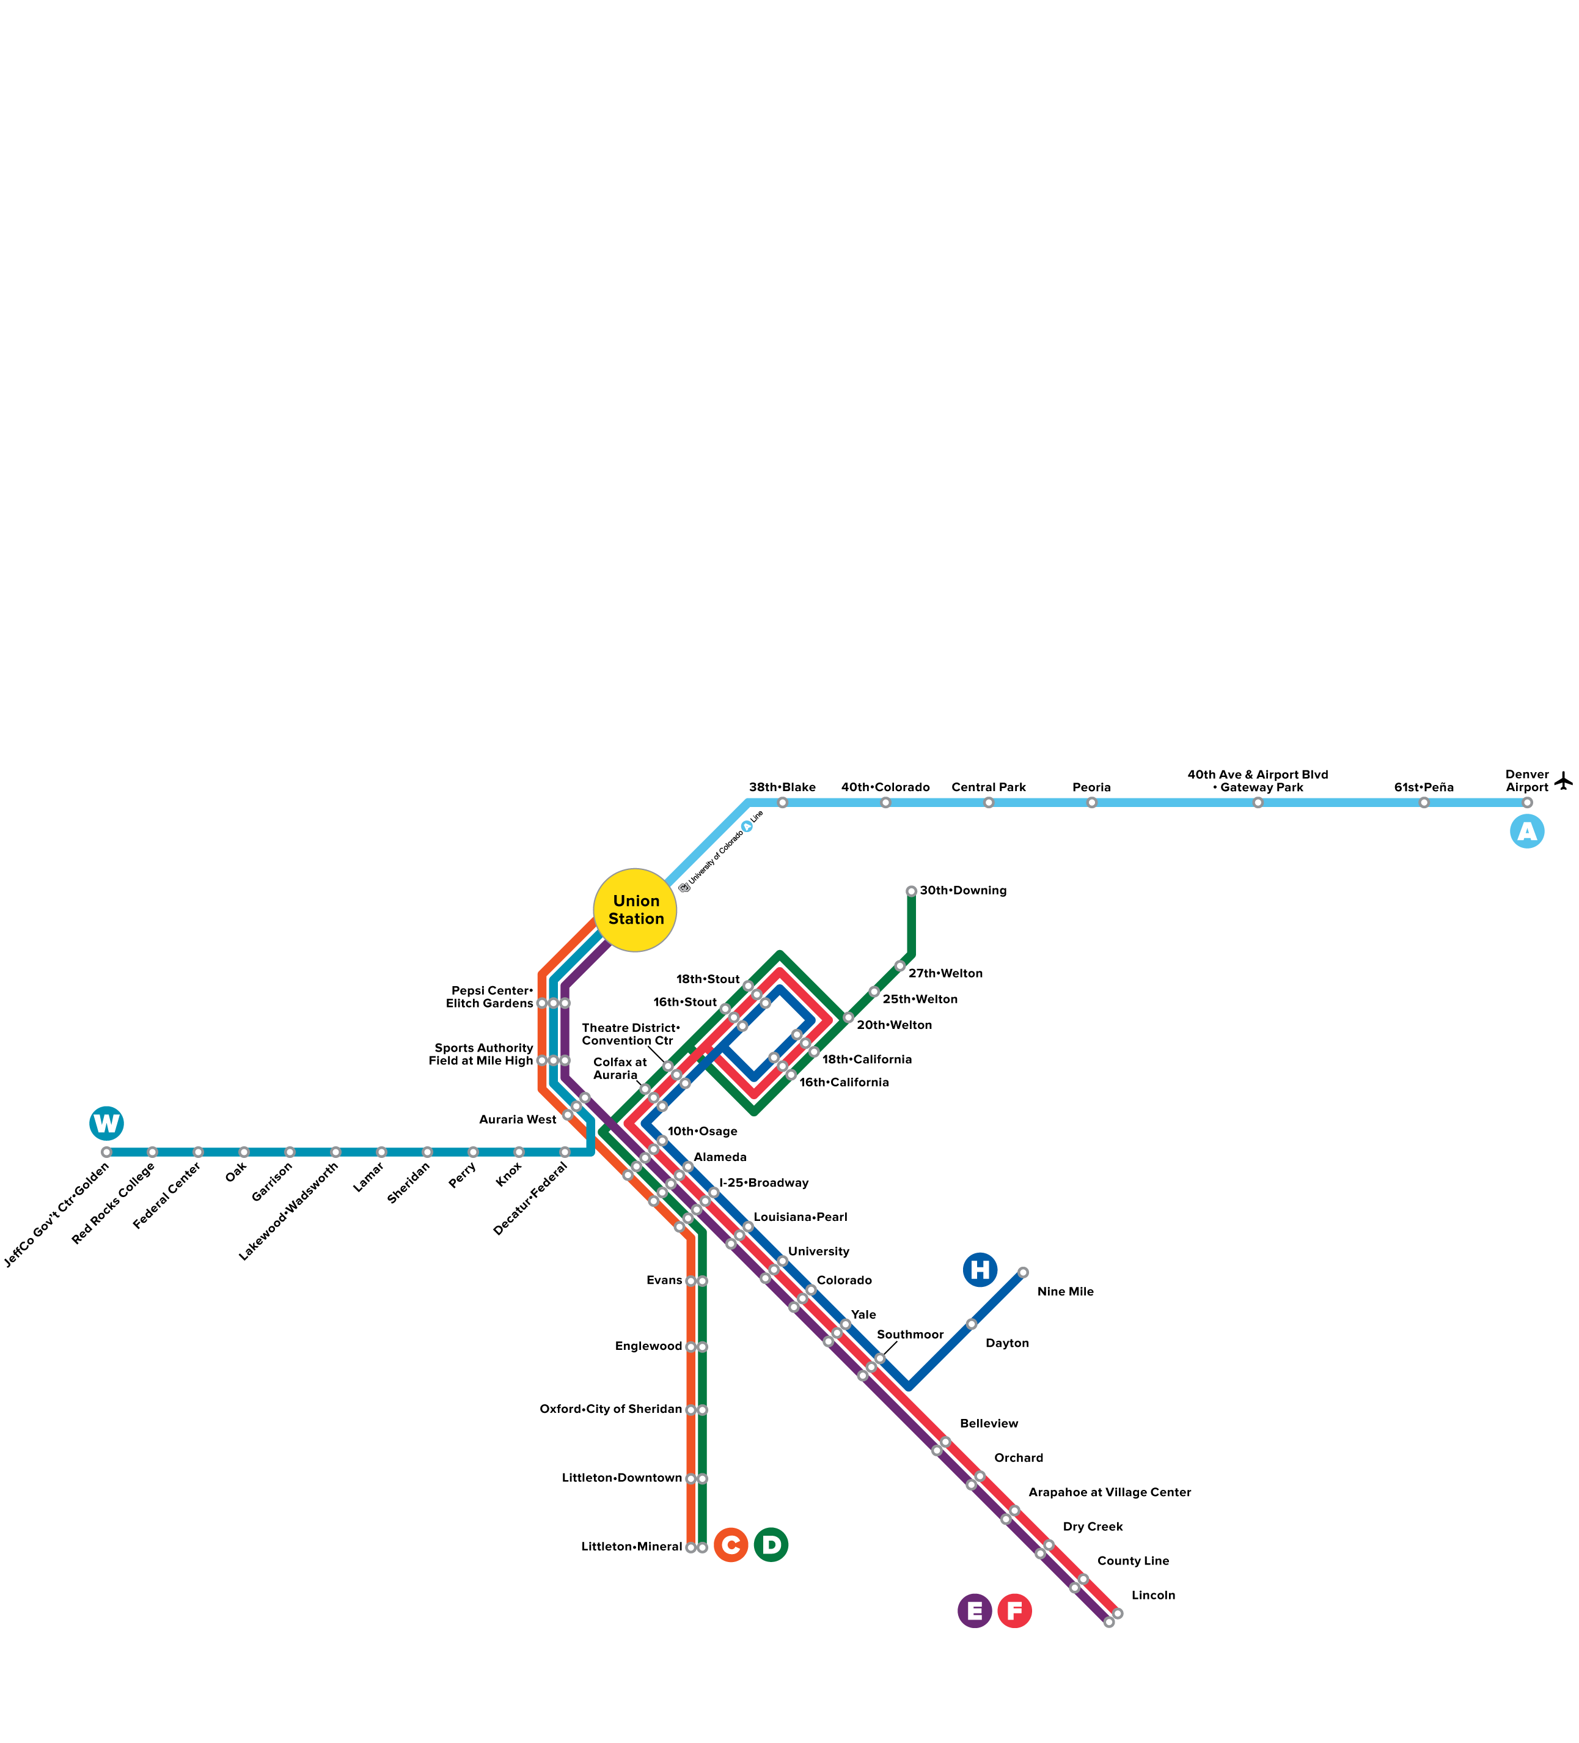
University of Colorado A Line 2016

Slide 9
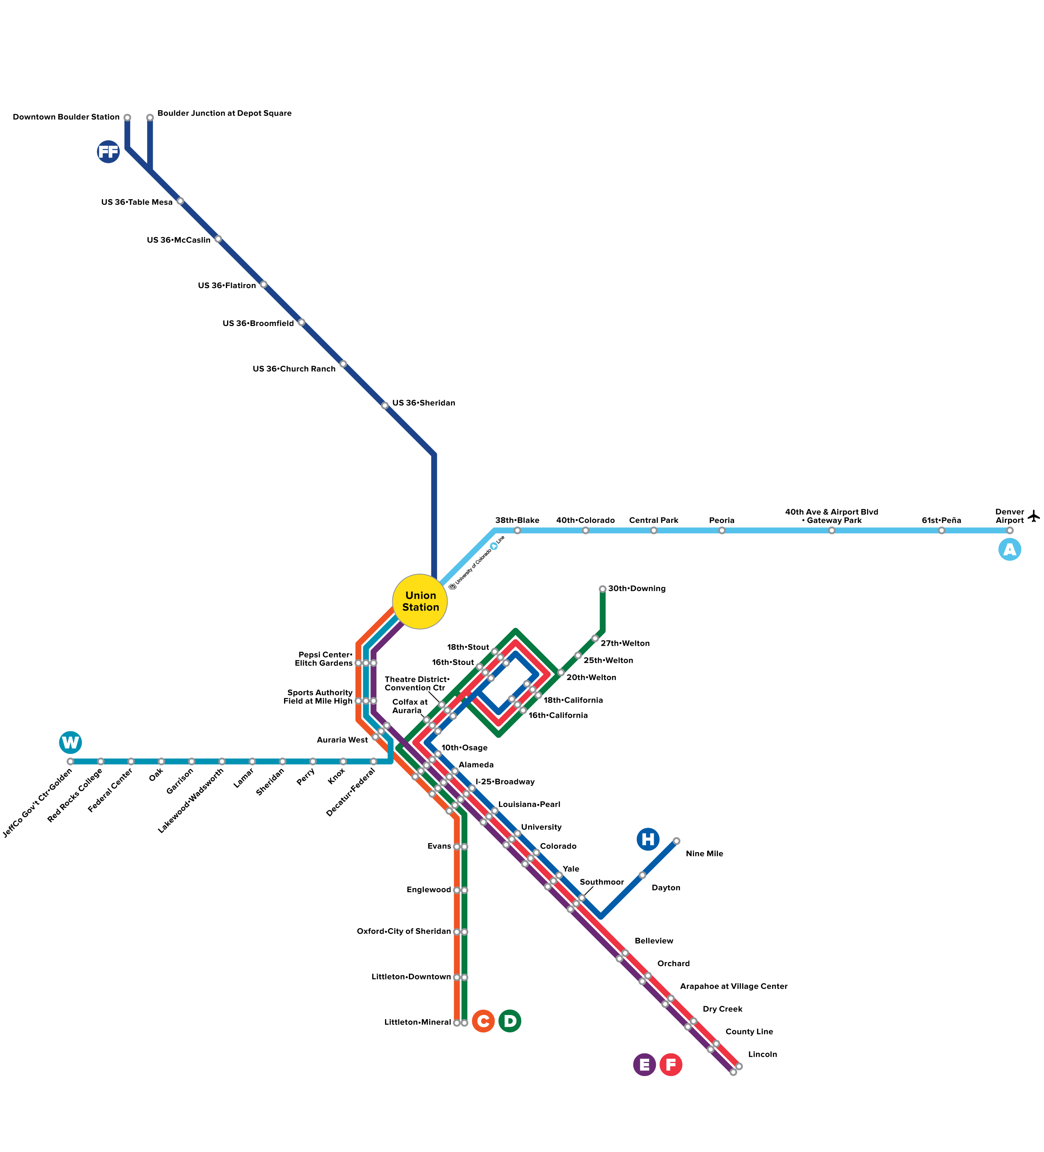
Flatiron Flyer 2016

Slide 10
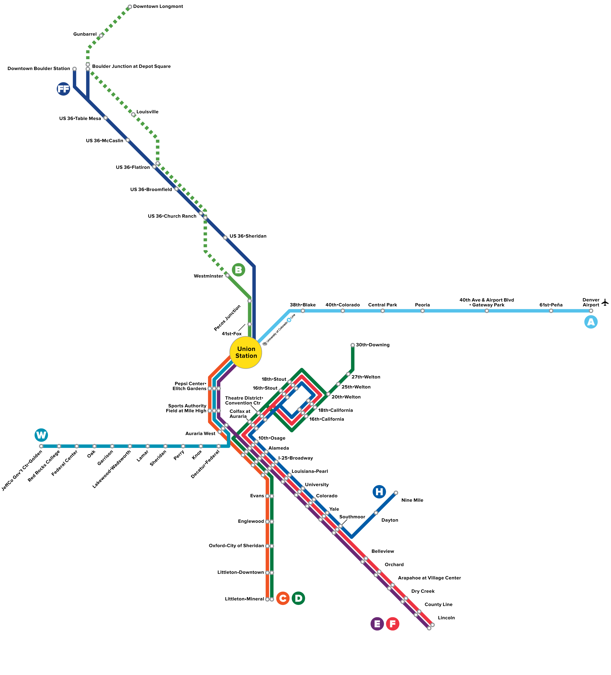
B Line 2016

Slide 11
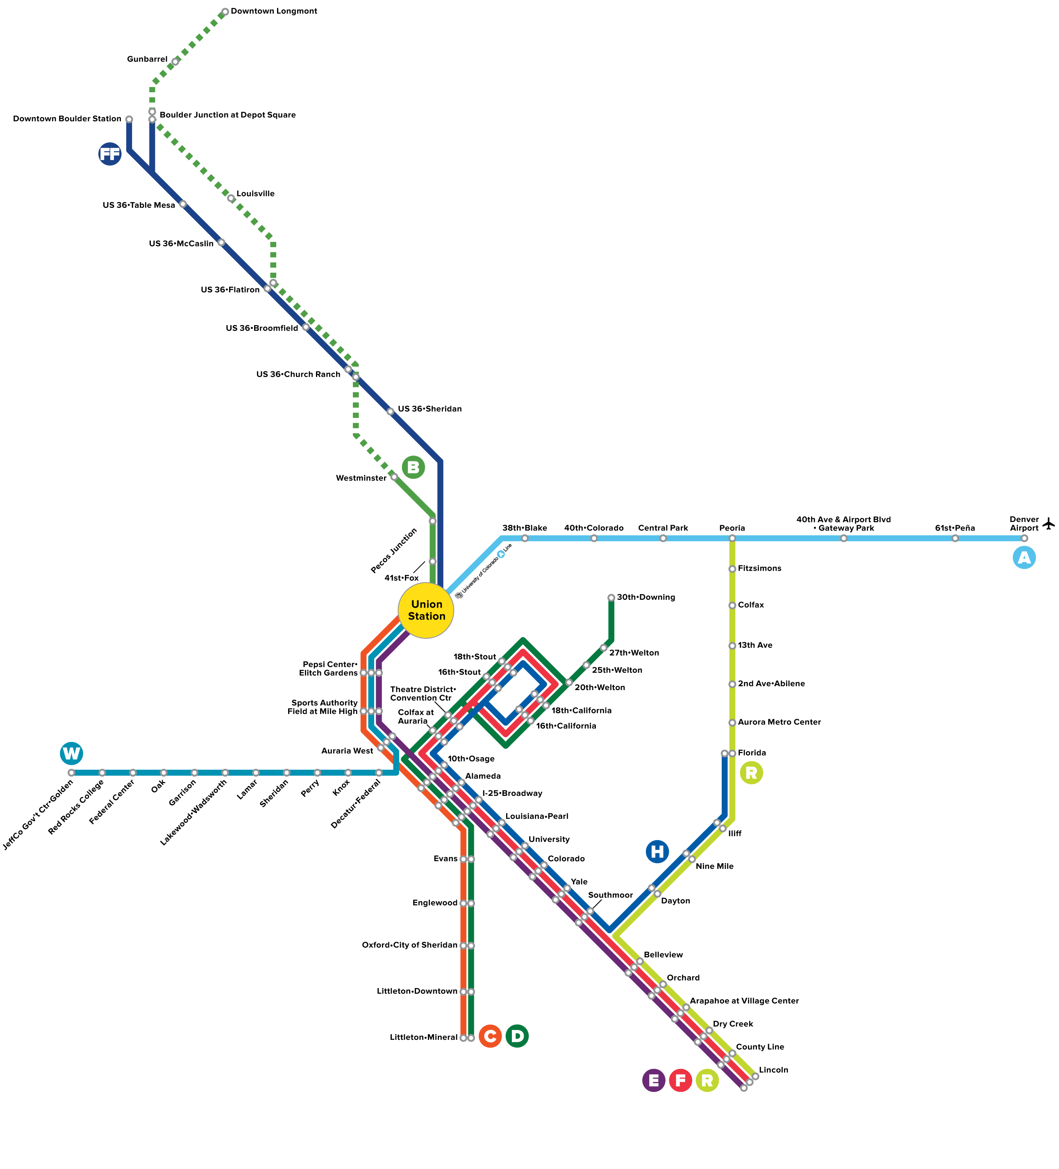
R Line 2017

Slide 12
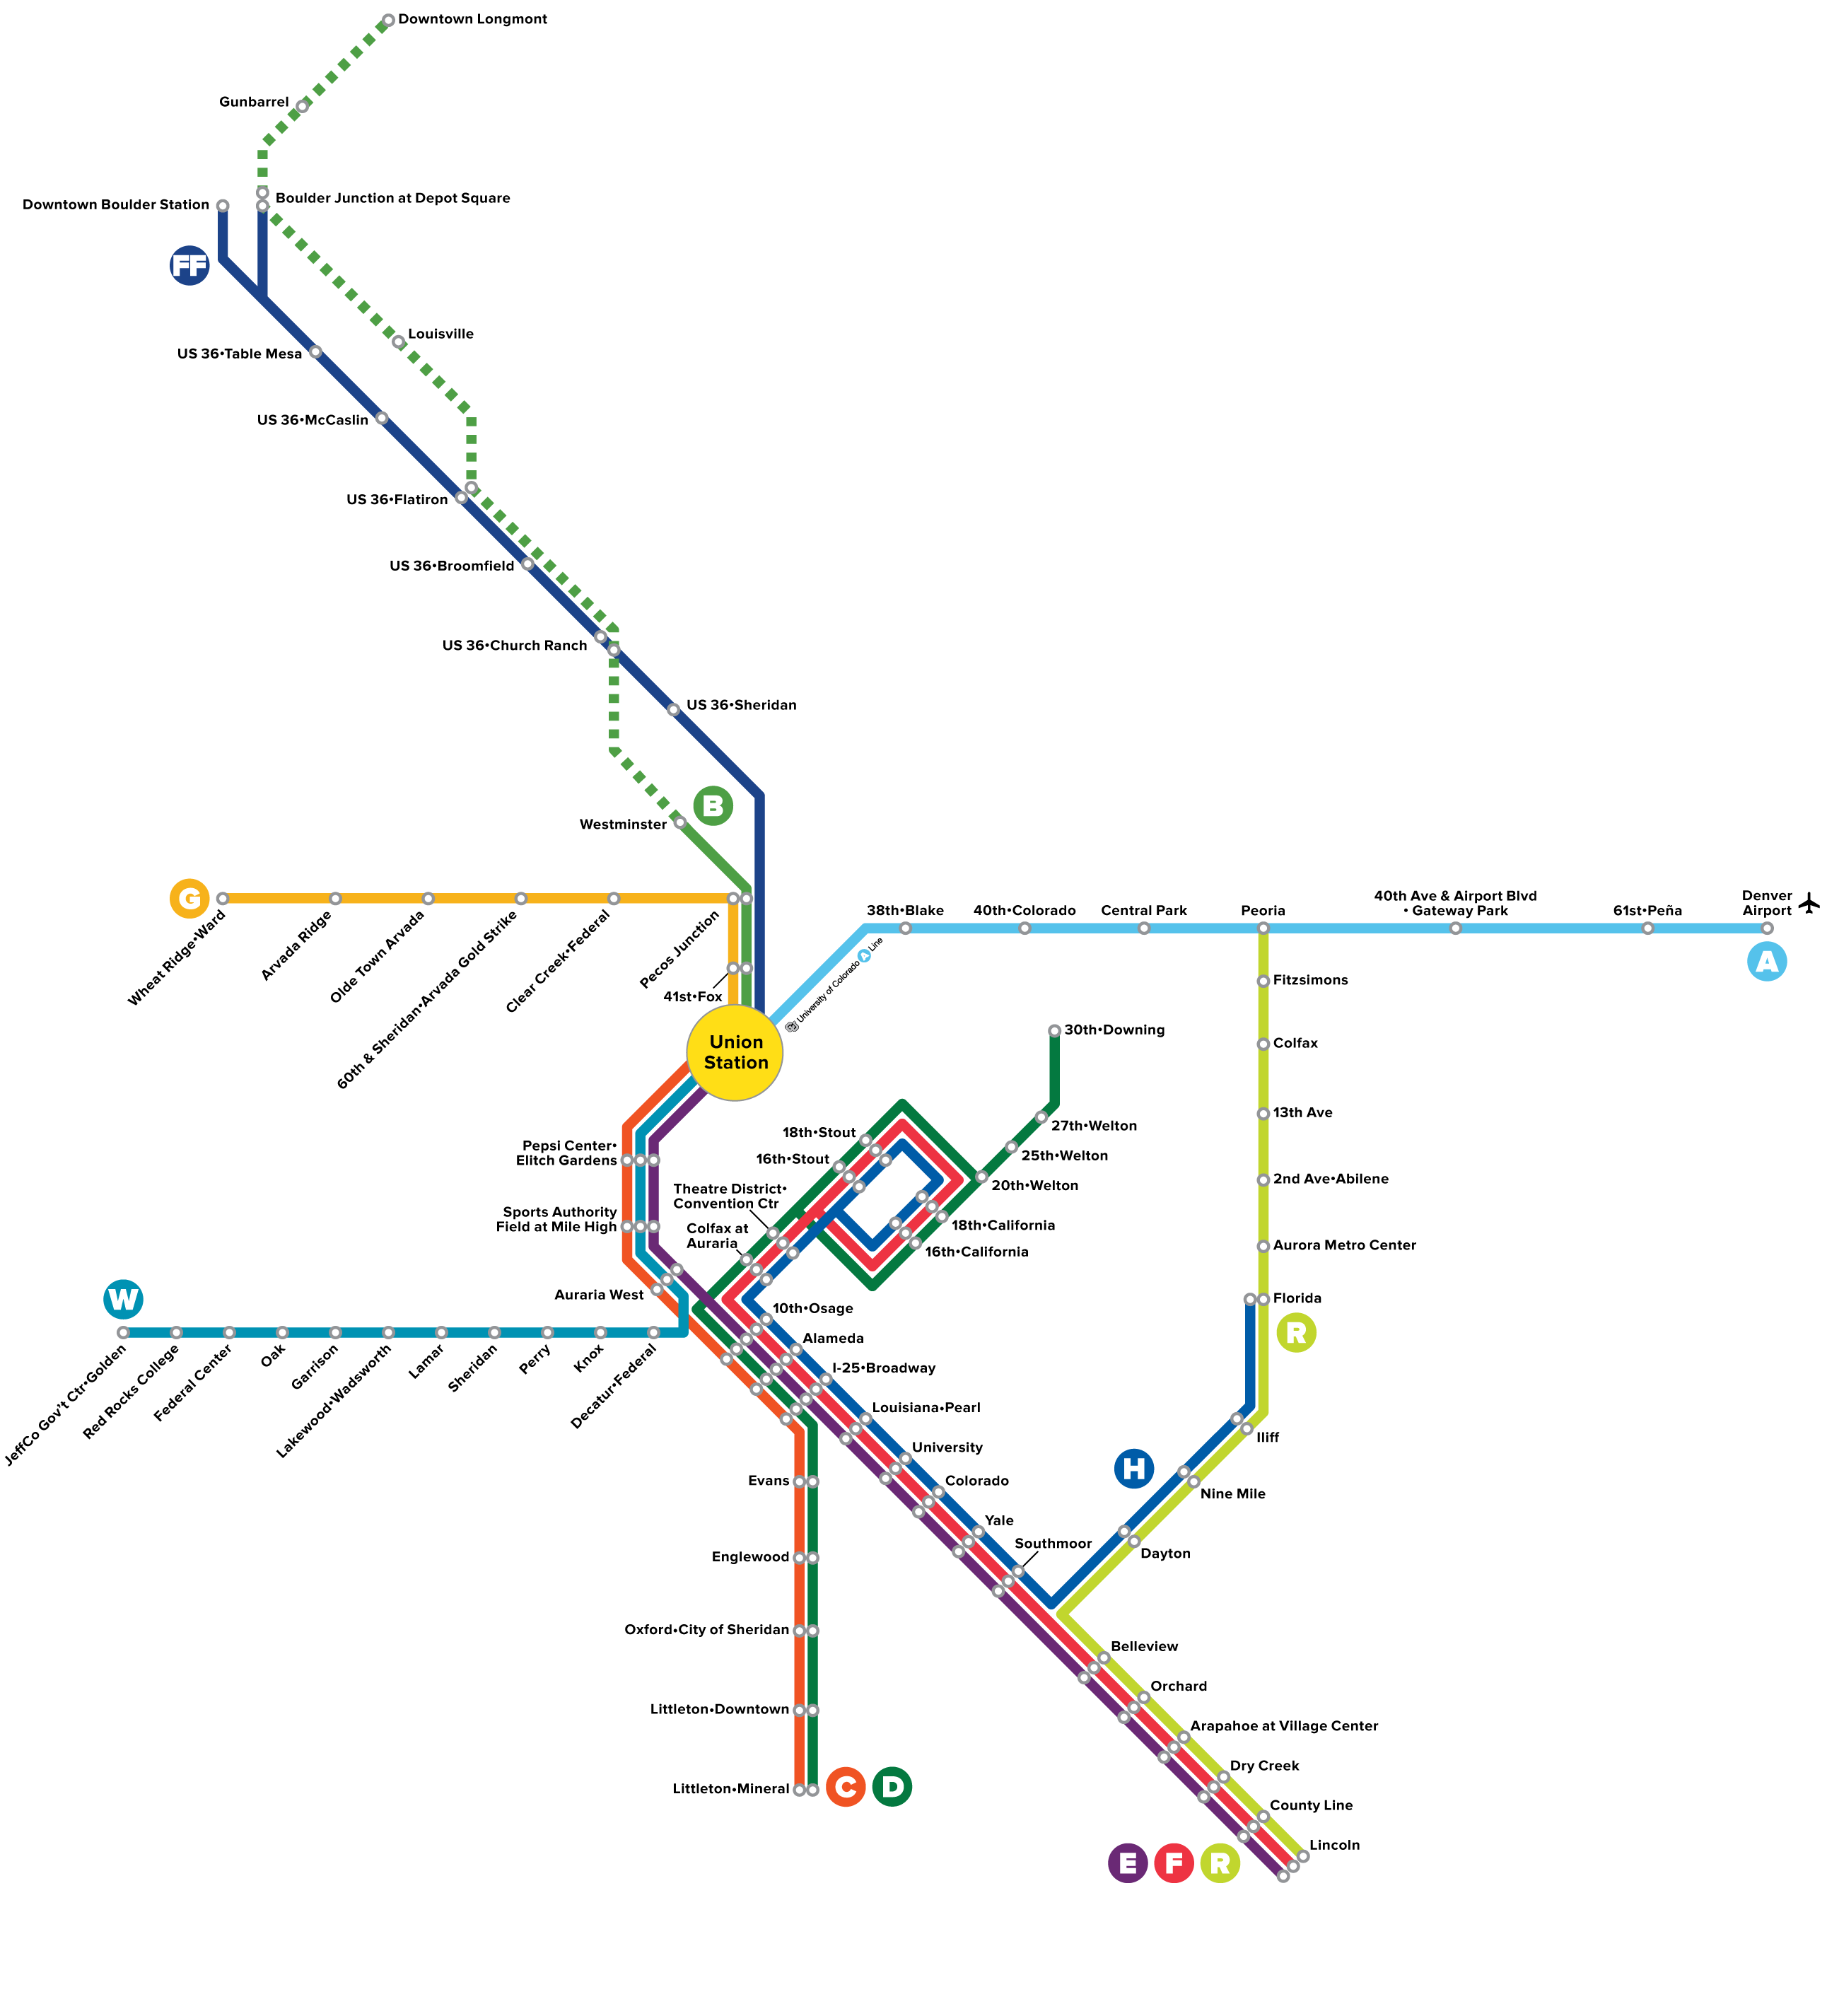
G Line 2017

Slide 13
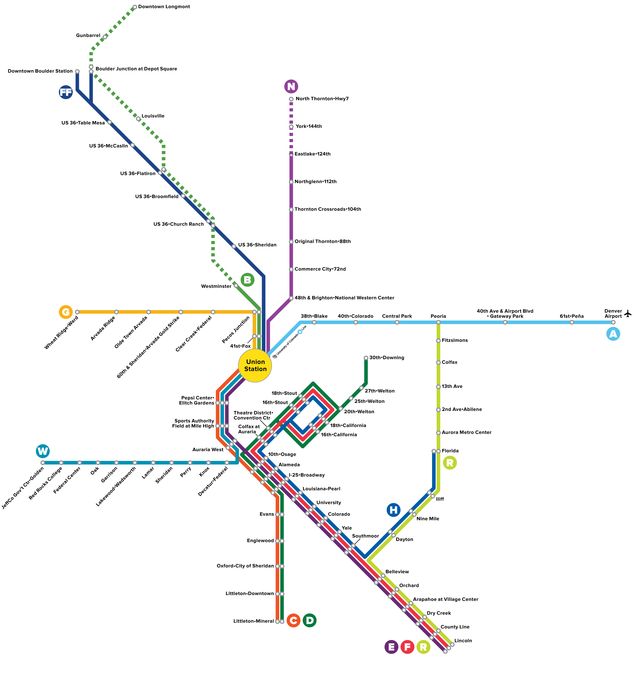
N Line

Slide 14
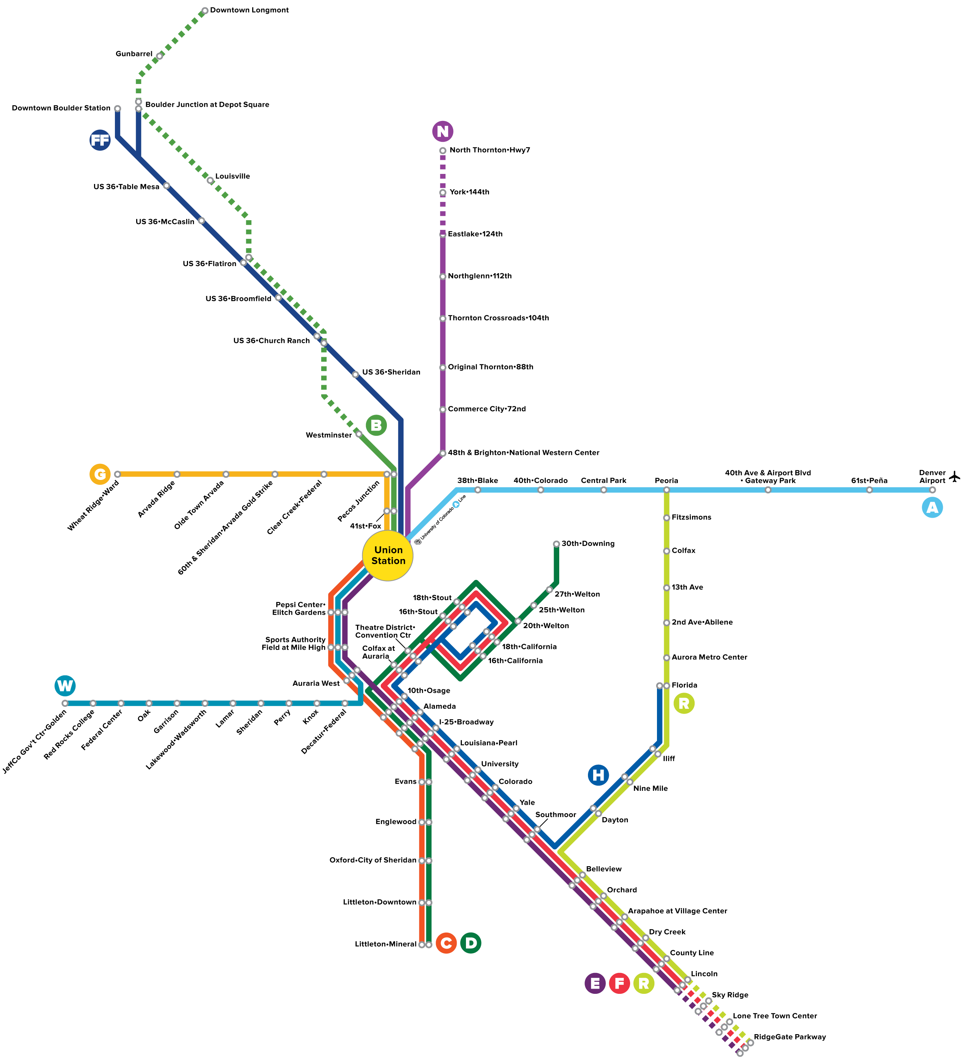
Southeast Rail Extension (EFR Lines)

Slide 15
2013 - 2019

Slide 16
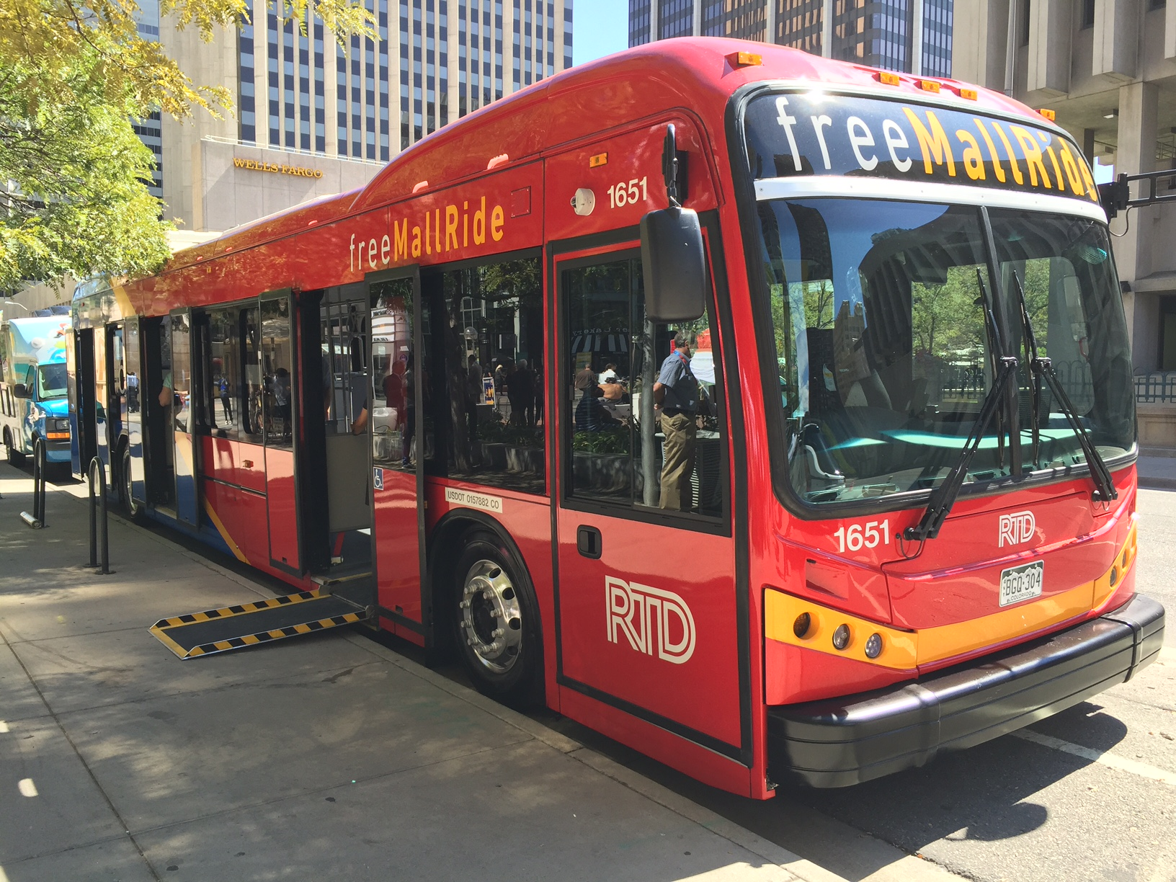
On the Horizon
Stored-value smart card
Mobile ticketing
Renovated Civic Center
New 36 bus all-electric 16th Street Mall Fleet
Improved real-time bus and rail information

Slide 17
DAVE GENOVA GM & CEO
REGIONAL TRANSPORTATION DISTRICT Denver, Colorado

