Slide 1
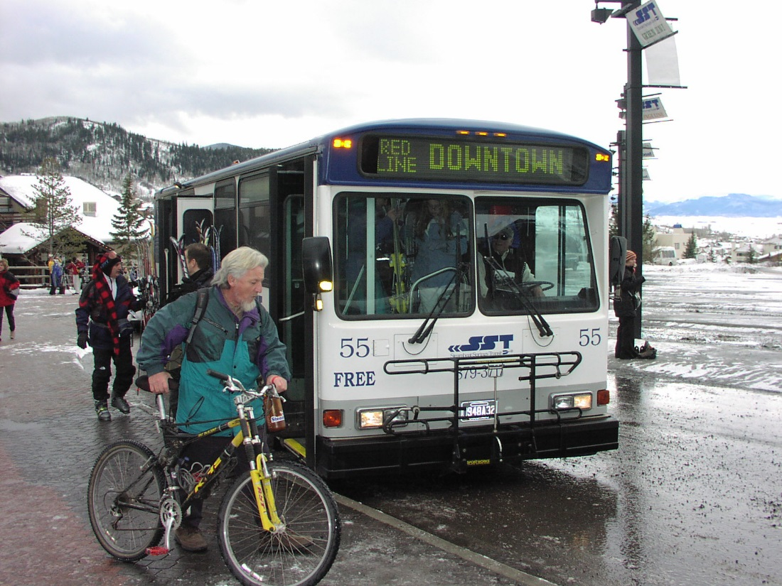
The Grant Partner Manual

Slide 2
Presentation
Provides a general overview of the manual and all of its chapters
Please ask questions as we go along
This is a “living document” and will never be “complete”
Changes occur as regulations change or CDOT shifts guidance; regular update review annually
Current document lives at:
https://www.codot.gov/programs/transitandrail/transit

Slide 3
Why Did We Write It?
Part of a documentation “trifecta”:
State Management Plan (SMP)
Grant Partner Manual (GPM)
Standard Operating Protocols (SOP)
Designed to supplement one another
Each targets a specific audience:
Everyone – Grant Partners – DTR Staff

Slide 4
Your Guide to Everything*
Designed specifically for grant partners
Includes information on as much as we can about your relationship with CDOT
Matched chapters across all three document sets
*Maybe not “everything”, but close

Slide 5
The Chapters:
1 – Introduction
2 – Definitions
3 – Goals & Objectives
4 – Planning
5 – Roles & Responsibilities
6 – Transit Program Overview
7 – DTR Support Programs
8 - COTRAMS
9 – Program Development and Project Approval
10 – Financial Management
11 – Program Management
12 – Procurement
13 – Asset Management
14 – Compliance & Oversight
15 - Templates

Slide 6
Purpose
Designed to provide you with immediate access to information, guidance, direction, and protocols for managing your relationship with CDOT and DTR

Slide 7
1 - Introduction
Describes the Grant Partner Manual
Outlines the crosswalk between the State Management Plan, Grant Partner Manual, and DTR Standard Operating Protocols

Slide 8
2 – Definition of Terms
Mirrors State Management Plan
Helps to ensure we’re speaking the same language

Slide 9
3 – Transit Program Goals & Objectives
Identifies the programs CDOT administers
5303 – Metropolitan Planning (Pass through to MPOs)
5304 – Statewide Planning
5310 – Enhanced Mobility for Seniors and Individuals with Disabilities
5311 – Rural Public Transportation
5311(b)(3) – RTAP
5311(f) – Intercity Bus (Transitioning to Rural Regional)
5339 – Bus & Bus Facility Formula
5339(b) – National Competitive Bus & Bus Facility
5339(c) – Low & No Emission Program
5309/5312 – Specialized programs (VTCLI, MSAA, etc.)

Slide 10
Chapter 3 – continued…
Purpose
The purpose of the Colorado Department of Transportation (CDOT) is to Provide Freedom, Connection and Experience through Travel.
Vision
To enhance the quality of life and the environment of the citizens of Colorado by creating an integrated transportation system that focuses on safely moving people and goods by offering convenient linkages among modal choices.
Mission
To provide the best multi-modal transportation system for Colorado that most effectively and safely moves people, goods, and information.

Slide 11
Chapter 3 – Goals & Objectives
Fund safe and efficient public transportation services throughout Colorado that meets the needs of our residents and tourists alike
Preserve and maintain existing transportation services and infrastructure
Facilitate the interconnectivity of our systems to provide seamless access from one end of the state to the other
Increase communication, collaboration, and coordination with and among providers within the statewide transportation network
Facilitate and support the creation of an interconnected system from transit systems (and systems) that will contribute to the economic vitality of the state, its regions, and its communities to reduce transportation costs for residents, businesses, and visitors
Facilitate and support a transit system in which travelers feel safe and secure and in which transit facilities are protected
Provide meaningful access to the national intercity bus network and support regional and interregional connections
Support and foster the coordination of services across all modes of transportation from pedestrian and bicycle to human services and medical transportation
Encourage new and innovative means of providing mobility to all Coloradans
Develop a framework to implement a transit system that is sustainable and environmentally beneficial over time
Create a transit system that will contribute to the economic vitality of the state, its regions, and its communities to reduce transportation costs for residents, businesses, and visitors
Create a transit system in which travelers feel safe and secure and in which transit facilities are protected

Slide 12
Chapter 4 - Planning
Describes the various elements of planning required of CDOT and how the state is organized
Describes the Transportation Planning Regions (TPRs) which form the basis of grant coordinator assignments
Statewide Transportation Plan – Primarily roads, does include reference to transit
State & Regional Transit Plans – First created in 2014, regional plans replace regional coordination plans required by FTA

Slide 13
Chapter 4 – STIP/TIP
Sections describe the Transportation Improvement Program (TIP) and Statewide Transportation Improvement Program (STIP)
TIP is local for MPOs
STIP is statewide and managed by CDOT
Roles and Responsibilities are outlined
Outlines who at CDOT does what

Slide 14
Chapter 5 – Roles & Responsibilities
Describes who is responsible for what
DTR
Provides organization chart (Subject to change)
Describes the functions of each unit in DTR
Provides current contact information
What are Project Managers?
Identifies grant coordinator by their region
Provides allocated TPR map
Functional responsibility chart
FTA Region VIII
Provides organization chart for the FTA region

Slide 15
Chapter 6 – Overview of Transit Programs
This chapter provides an overview of the current CDOT administered programs
Helps you to understand the “other” programs and determine whether to apply or not
Format:
Description
Program Goals
Eligible Recipients
Eligible Projects

Slide 16
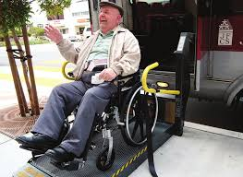
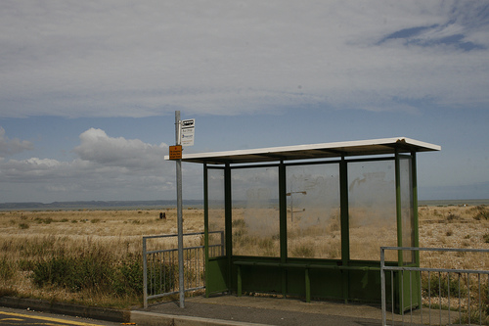
Chapter 6 - Outline
Section 5310
Includes discussion on coordination requirements
Section 5311
Separates out 5311(f) – describes rural regional plan
Calls out Bustang
Separates 5311(b)(3) - RTAP

Slide 17
Chapter 6 – Outline continued…
Section 5304
Includes links to available TPR websites
Section 5339
Provides list of potential projects for funding
Section 5312
Research program that provides diverse funding opportunities.
Includes VTCLI, MSAA, Rides to Wellness, etc.
State FASTER Program
New section on Senate Bill 228 program
Other funding opportunities

Slide 18
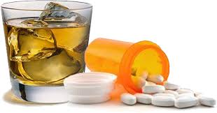
Chapter 7 – Support Programs
Drug & Alcohol
DTR hires a consultant to provide support functions including:
Triennial Drug & Alcohol reviews
Training on Reasonable Suspicion & Post-Accident
Reports on Colorado trends
Other support (DAMIS annual reporting)

Slide 19
Chapter 7 – Support continued…
Coordinating Councils
DTR hires a consultant to provide local/regional technical assistance to coordinating councils
DTR hires a consultant to provide administrative and technical support to the State Coordinating Council
Mobility Management
CDOT supports efforts of the Colorado Mobility Action Coalition (CMAC)

Slide 20
Chapter 7 – More Support
Technical assistance
May be staff or consultants
Occasionally may use other grant partners as resources
In any area of need
Coordination
Maintenance
Finance
Asset Management
COTRAMS

Slide 21
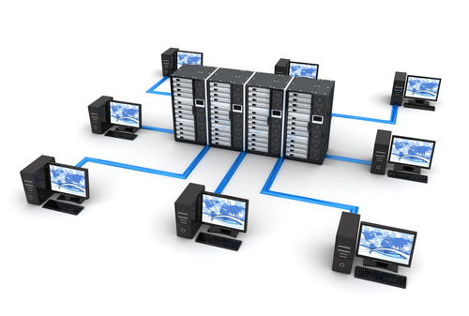
Chapter 8 - COTRAMS
Provides an outline of the COlorado Transit & Rail Awards Management System
Portal
Agency Profile
Inventory Module
Vehicle Disposition Module (Coming soon)
Applications
Project Budget
Reimbursement
Procurement (Coming soon)

Slide 22
Chapter 9 - Applications
Call for Projects
Application Process – COTRAMS
Risk Assessment Process
New under 2 CFR 200 (Uniform Guidance)
Required for every application, may change based on project, i.e. if you’ve never applied before, risk is higher

Slide 23
Chapter 9 – Match Rates
Local share is required (Few exceptions)
Capital, Capital operating, Construction, Planning: 20% match required
Operating: 50% match required
In kind as match
Only allowed for Capital operating and Operating
Maximum allowable is 50% of local match
Must have relevance to project being funded

Slide 24
Chapter 9 – Alternate Match Ratios
DTR has established a standard match rate for federal and state funding
Capital is 80:20
Operating is 50:50
There is a federal option to bring local match down due to amount of federal land in Colorado (reduction of tax base) – Colorado has chosen NOT to use this because of lack of funds
Some boutique programs have different rates

Slide 25
Chapter 10 – Financial Management
What makes a good financial management system?
What does CDOT need from you?
Timely submission of invoices
All required backup documentation
We strive for reimbursement <30 days*
*30 days starts when you submit complete and accurate documentation. If it is rejected, the time starts when you submit again!

Slide 26
Chapter 10 – Indirect Costs
Allowable expense
Must have approved indirect cost rate on file with CDOT prior to application
Approval is annual from CDOT Audit Division
Only allowable for Operating, Capital Operating, Planning
Rate must be included in grant agreement

Slide 27
Chapter 10 – Capital Costs
May only charge costs associated with the scoped asset
If funds remain, you may be able to expend, if within scope
Options & add-ons may be allowed but only if not substantial and relevant to asset or service procured
Must be approved, may not extend life of grant agreement

Slide 28
Chapter 10 – Operating
Eligible expenses are associated directly with the operations being funded
Vehicle expenses, i.e. fuel, maintenance, parts, driver or mechanic wages, contracted services
Administrative costs may be charged to operations @ 50:50 or under separate program
Rents, management salaries, support services such as HR or Finance, etc.
Often these are part of an indirect cost rate

Slide 29
Chapter 10 - Reimbursement
CDOT currently operates on a reimbursement basis
All costs you are seeking reimbursement for must have documented payments
Please be timely, we are tracking to expectation (i.e, we should see 6 reimbursement requests by September 1)
All reimbursements go through COTRAMS for easier approval and tracking

Slide 30
Chapter 10 – Financial Reviews
One of the optional program reviews
Also part of the application vetting processes
We need to see/understand your financial management systems
Minimally part of the triennial agency review
Part of the required risk assessment process
Performed by finance professionals

Slide 31
Chapter 10 – Agreement Modifications
The grant agreement is the legal/formal document controlling the project
Modifications may occur:
Grant agreement needs to be extended
Substantive change to scope
Modification should be rare
Check your grant agreement BEFORE signing, the scope can be changed then

Slide 32
Chapter 10 – Grant Closeout
Just because you ran out of money in the grant/ finished the project does not mean we are done
Grant closeout is the final stage
Once you have received reimbursement for your final invoice, a Grant Closeout/Liquidation (GCL) form should be completed
This closes the grant agreement, releases any remaining funds, and closes out the associated purchase order
There may be a final report required (Program based)

Slide 33
Chapter 11 – Program Management
Program management refers to the general requirements for accepting state or federal funding from CDOT
Includes several compliance requirements
These are essential for a good relationship

Slide 34
Chapter 11 – Required Certifications
Annual FTA Certifications & Assurances
These change every year, may be minor but still require some attention
Required of all agencies receiving ANY FTA funds (Includes 5339, 5312, etc.)
Core elements are required of everyone
Specifics only apply if you receive that funding
i.e. category 15 (2016) only for recipients of 5310 funding, category 17 only for Tribes, etc.

Slide 35
Chapter 11 – DTR Certifications
DTR responsible for managing eligibility and other compliance issues
We ask for certifications to maintain on file
5310 Certification – Verify type of eligibility
School bus and Charter bus certifications
5311 annual Labor certification

Slide 36
Chapter 11 – Compliance Documents
This year was the 1st for collecting, needed everything which made this tough
Title VI plan – Federal recipients only (CRBRC has created triennial schedule)
Limited English Proficiency (LEP) Plan – part of the Title VI plan
ADA Service plan (Fixed route)
Drug & Alcohol Policy – 5311/5339 Recipients
Procurement Policy
Fleet Maintenance Policy
Asset Management/Safety & Security Plan (When adopted)
LLL Lobbying disclosure – initial on file, only new when modified substantively
DBE Plan – not reviewed by CDOT; only for direct recipients who meet thresholds
EEO Plan – federal recipients; only if threshold met 1 million + 50+ transit employees

Slide 37
Chapter 11 – Why?
We maintain these documents on file to:
Ensure you are in compliance with FTA and State regulations and requirements
Don’t have to supply these documents ad hoc, we can check up without having you do all the work
Templates for some elements are available
Manual does provide guidance

Slide 38
Chapter 11 - Reporting
What reports are you responsible for?
Monthly: Monthly Operating Report (To Grants Unit Manager)
Quarterly: Updates for construction; remaining 5309, 5316, and 5317; charter service report; narrative report for 5310 (and remaining 5316 & 5317)
Semiannual: DBE report
Annual: NTD, DAMIS (both 5311); for FTA funded facility – status, condition, & affirmation of use

Slide 39
Chapter 11 – Internal Civil Rights
Responsible for employment practices
EEO
ADA (Specific for employment)
Fair Labor Standards
Complaints
Confidentiality
Public Access
Title VII

Slide 40
Chapter 11 - ADA
There are transit elements of ADA
Most relate to provision of services:
If fixed route, must provide complementary paratransit in some form, must call out major stops and connections, and fleet must be accessible
If demand response, fleet must be accessible
Information (print, online, meetings) must be offered in alternative formats and offer must be mentioned everywhere including stops and facilities

Slide 41
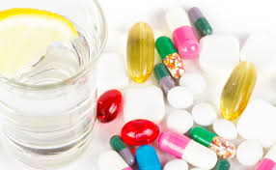
Chapter 11 – Drug & Alcohol
Drug Free Workplace required of all grant partners – requires notices & policy
5311 Drug & Alcohol testing program
Safety sensitive employees must be covered
Requires testing:
Pre-Employment
Random
Post-Accident
Reasonable Suspicion
Return to work (if off more than 30 days or return from treatment program, if offered)

Slide 42
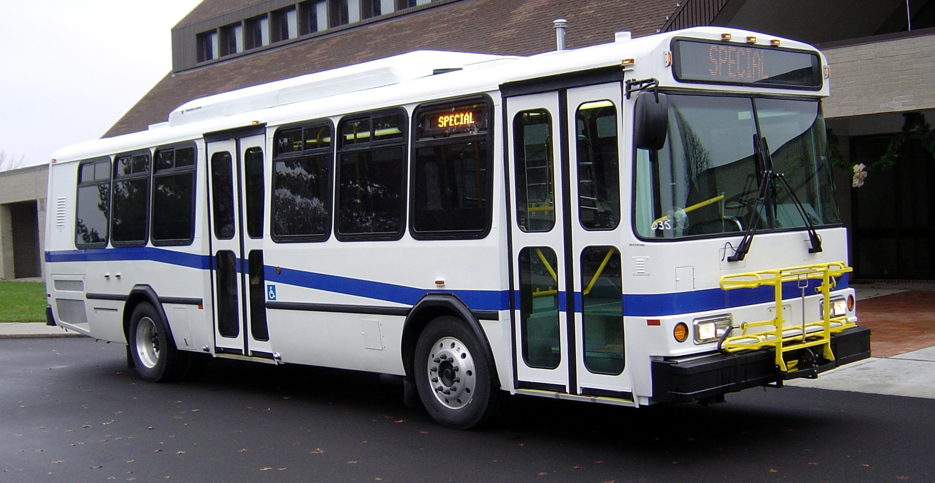
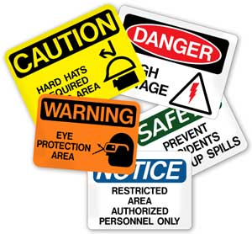
Chapter 11 – Asset Management & Safety & Security
Will be required
Final rules just announced
Asset management plan for most agencies will be based on DTR Asset Management Plan
You may choose to have your own
Safety & Security now being developed

Slide 43
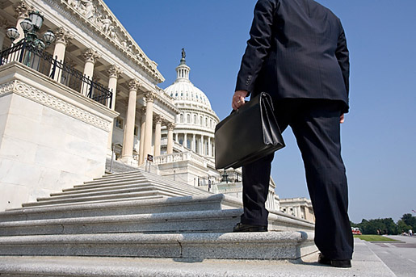
Chapter 11 - Lobbying
Initial: All grant partners required to file certification form LLL
Includes if you do not lobby!!!
Required update for substantive change
Changes include:
Change in lobbyist
Change in federal funds per year (±10%)
Certification clause is in annual FTA Certifications & Assurances

Slide 44
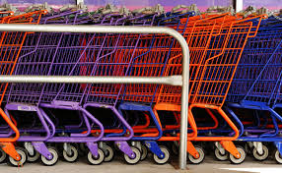
Chapter 12 - Procurement
Entire Chapter is the Procurement Guidebook
Does not include forms!
Format is different
Definitions
Micropurchase (<$3,500)
Documented Quotes ($3,500 - $150,000)
Large Procurement (>$150,000)

Slide 45
Chapter 12 – Procurement Methods
Price Agreement/Consortium
Procurement process is vetted and approved
You just have to order from the approved list
Easy process, may be limited in options, etc.
Piggyback
Buy off a price agreement you were not originally involved with
Requires CDOT vet the original documentation
Self Procured

Slide 46
Chapter 12 – CDOT Oversight
We ensure your compliance with state and federal procurement regulations
Federal clauses
Federal and state certifications
Compliance with procurement regulations
Procurement Concurrence Request (PCR) – we make sure your process is compliant
Procurement Authorization (PA) – we approve your decision
Procurement Review – as needed to ensure your policy/process is compliant

Slide 47
Chapter 12 – General Requirements
Written procurement process & policies
Must be in writing and must be followed
Includes reference to federally funded procurement requirements
Key element: No geographic preference!
Open and competitive process
Must include written protest procedures
Should reflect conflict of interest/ethics

Slide 48
Chapter 12 - Documentation
Procurement file
By individual procurement
Includes all documents related to this specific procurement
Includes all documents from price agreement or consortium purchase
Generally, PCA covers the solicitation documents by referring to original procurement by master agent
Must be kept for at least 3 years after procurement has concluded

Slide 49
Chapter 12 – Specific Elements
Independent Cost Estimate (ICE)
Shows that you did your homework to determine a reasonable price for the asset
Usually a part of your original application
Specifications – What do you specifically want?
Distribution – Where did you advertise?
Selection Process/Criteria – How did you choose the successful vendor?
Award & Delivery Documents – Did the vendor certify compliance with federal & state requirements? Did you get what you ordered?

Slide 50
Chapter 12 – Detailed Steps
Provides a step-by-step protocol for completing a procurement with options
Follows a simple flow chart structure, i.e. if using this method then go to step X
Discusses sole source as well

Slide 51
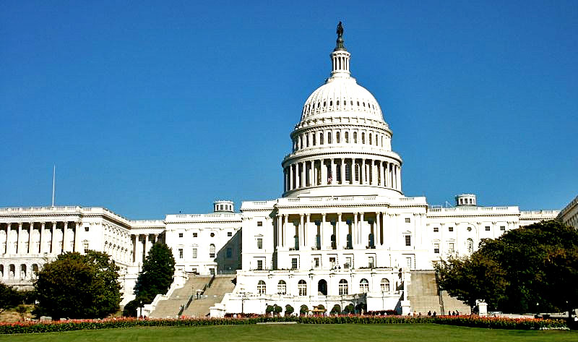
Chapter 12 – Clauses & Certifications
Provides a detailed options list for all federal and state required clauses by type of procurement
Identifies required certifications, must be maintained in procurement file

Slide 52
Chapter 13 – Asset Management
When assets are acquired with state or federal funds, you are required to maintain them in good order
Asset Management Plan
Required for all grant partners (including if no assets with state or federal interest)
There will be a Colorado Asset Management Plan to include all grant partners who are not direct recipients

Slide 53
Chapter 13 – Vehicle Asset Management
Maintenance Plan
You must show that you plan on taking care of the assets
Reference manufacturer’s standards for preventative maintenance
Identifies minimum useful life (MUL)
MUL required for determining eligibility for replacement
Condition Assessment

Slide 54
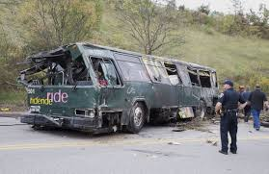
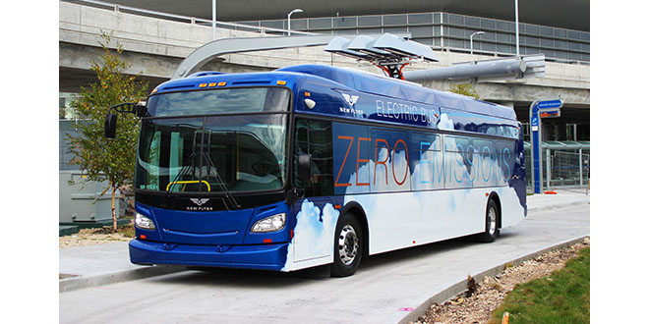
Chapter 13 - Inventory
Tracks asset – required for funding replacements
Includes current information, updated annually
Mileage
Condition
Status (Active, Spare, etc.)

Slide 55
Chapter 13 – Vehicle Disposition
Not a new requirement but new oversight by CDOT
There will always be a federal and/or state interest in any asset originally procured with state and/or federal funds
When you dispose of an asset:
If under $5,000 – please use funds in your transit program
If over $5,000 – there is a state and/or federal “interest” in the asset

Slide 56
Chapter 13 – Asset Sale
If you dispose of an asset by sale
Must be competitive
Cannot assign price, no $4,999 specials
Must reflect fair market value (See definition in Chapter 2)
Preferred method is auction (Also use eBay)
Take proceeds and apply original purchase federal and/or state interest
Usually 80% but may be different if you had FASTER as match (96%) or overmatched
Submit bill of sale, approved Asset Disposition (AD) form, copy of received check, disposition check to Grants Unit Manager

Slide 57
Chapter 13 – Disposition Proceeds
Grants Unit Manager will verify all document and submit the check to Finance for deposit
Please update the inventory record in COTRAMS
This process will be automated in future
Disposition proceeds go into a specific account (FTA or FASTER)
Where there are sufficient funds, balance will be transferred into the annual capital call
Disposition funds will be treated as regular FTA or FASTER funds, as appropriate

Slide 58
Chapter 13 - Parting
If vehicle has reached the end of its useful life and is no longer capable of being used, you may choose to part it out
Must be “like” vehicle to remaining fleet
Must track parting to newer vehicles
If you take the alternator out of the parted vehicle and install it in a different vehicle (in service), please note in the new vehicle’s file
Once no longer useful, sell for scrap
If sale proceeds are over $5,000, use sale disposition process.

Slide 59
Chapter 13 - Donation
You may choose to donate a vehicle that is past its useful life to another entity
Entity must be approved by CDOT (on behalf of FTA, may require FTA approval) to ensure vehicle use meets FTA requirements
Vehicle must be appraised by approved source
If fair market value is over $5,000, receiving entity must accept responsibility for annual reporting until the asset is sold

Slide 60
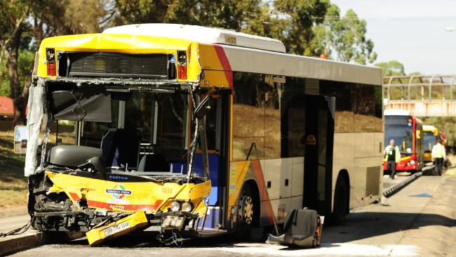
Chapter 13 – Casualty Loss
If vehicle is totaled:
Expectation is that it will be replaced
If this is NOT the case, contact your grant coordinator IMMEDIATELY upon loss
Make sure the accident information is completed in COTRAMS, helps us track events
Work with insurance to resolve claim

Slide 61
Chapter 13 – Replacing Loss Vehicle
When you receive settlement:
Determine replacement cost
Apply settlement to price of replacement using original purchase state and/or federal interest (80%, etc.)
If you are paying the remainder with local funds, the federal/state interest is the settlement interest percentage of whole
For example, if the settlement is $20,000 and you are paying the remaining $80,000 from local funds, the federal/state interest is 20%
If you are seeking CDOT assistance for the replacement, then the federal/state interest is from the new grant plus the settlement interest, usually 80%

Slide 62
Chapter 13 – Equipment & Facilities
Equipment and facilities are treated much like rolling stock:
There is a useful life
You must have a maintenance plan
Equipment has the same disposition requirements >$5,000
Remember, equipment includes major components such as bus washes, bus lifts, etc. which could be sold
Facilities do not have an end date for interest and have separate requirements for sale of assets
Facilities do include shelters, benches, etc. which are treated like equipment

Slide 63
Chapter 13 - Leasing
Two types:
Agency leases a vehicle from a dealer
Agency leases their owned vehicle to a contractor
Lease of vehicle from dealer
Not usually allowed unless for limited duration “bridge lease”
Lease to a contractor requires FTA or CDOT approval

Slide 64
Chapter 13 – Leasing to Contractor
FTA and/or CDOT must ensure your lease agreement complies with requirements
The responsibility remains with you, did you pass on the requirements to the contractor?
Includes maintenance requirements, drug & alcohol (as applicable), insurance, staff training, etc.
Failure to receive approval may make some or all expenses from the contractor ineligible for state or federal funding

Slide 65
Chapter 14 – Compliance & Oversight
CDOT is the direct recipient of federal funding from the FTA
Our role is to act as “agent” on behalf of FTA to ensure that all grants are being managed and operated in compliance with the federal regulations
Simple rule: failure to comply = risk of losing funding
Our job: help you to be in compliance

Slide 66
Chapter 14 – Agency Reviews
Triennial review of your entire operation
Desk Review: Held @ CDOT, reviewer checks to ensure we have documentation on file, reports are up to date, grants are timely
On Site Review: Held at your location(s), reviewer will go through a process to ask questions, gather backup evidence, and review files; complexity depends on your program(s) and services
You are obligated to ensure all required staff are present and available for questions

Slide 67
Chapter 14 – Functional Reviews
Specific to one function
Drug & Alcohol: most common, DTR has contractor perform these every three years, contractor provides technical support
Financial: review of your financial systems and management processes
Procurement: review of your procurement documentation and procedures
Maintenance: reviews your maintenance plans and procedures

Slide 68
Chapter 14 – Functional Reviews
ADA: reviews your ADA compliance, usually specific for fixed route operations
Asset Management: uncommon but may occur if fleet is in poor condition
Safety & Security: coming after FTA releases guidance
School Bus: required if you provide tripper service to ensure compliance
Charter Bus: required if you provide charters

Slide 69
Chapter 15 - Templates
Intent is to provide templates of most of the documents required by CDOT/DTR
Currently:
Vehicle minimum useful life
Equipment minimum useful life
Real property minimum useful life
Planned:
Title VI plan template
LEP plan template
And…..? Please suggest!

Slide 70
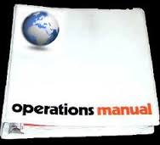
Summary
Grant Partner Manual is our first attempt at providing every grant partner with a tool to assist you with your relationship with CDOT
This is YOUR manual
Please suggest improvements
If it doesn’t work for you, it doesn’t work!
Structure cannot change but content can
How can we help you?

Slide 71
Grant Partner Manual Contact
Brodie Ayers
Lead Grants Coordinator
brodie.ayers@state.co.us
303.757.9767 desk
720.990.0095 cell

