Slide 1
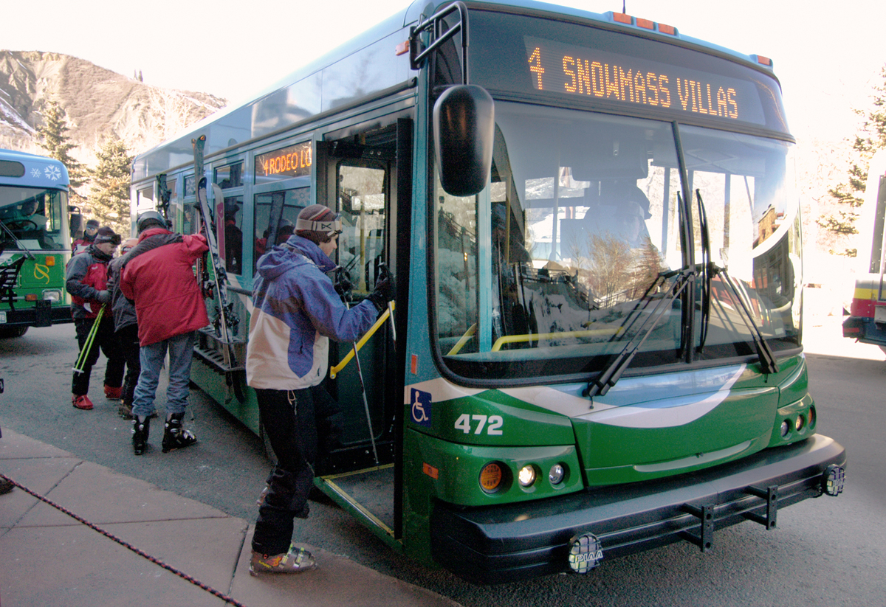
What Did I Agree To? – Compliance Today

Slide 2
Federal Regulations
You want federal funds? You have to follow federal rules.
CDOT is tasked with acting on behalf of FTA
Requirements usually found in circulars:
5304 – 8100.1C
5310 – 9070.1G
5311 – 9040.1G
5339 – 5100.1
ADA – 4710.1
Grants Management – 5010.1E
Title VI – 4702.1B
Third Party Contracting – 4220.1E

Slide 3
State Funds (FASTER)
Generally match FTA requirements
No Buy America
Does include ADA, Title VI, etc.
No additional burdens

Slide 4
All Federal Funds
Annual Certifications & Assurances
Same as direct recipients: CDOT, RTD, etc.
No requirement for attorney signature
They do change every year
Required ~January/February when released by FTA

Slide 5
What Are the Certifications?
01 – Authority, General, Intergovernmental Review, Nondiscrimination (Title VI, ADA, etc.), Suspension & Debarment, OMB Assurances (Adequate resources, access to data, etc.)
02 – Lobbying: Over $100K, Certification on file @ CDOT, change only when “substantive” change

Slide 6
Certifications, cont…
03 – Procurement and Procurement Systems: Comply with federal and state regulations, open, competitive, not geographically restrictive, etc.
04 – Private Sector Protections (noncompete), Charter Service, School Bus
05 - Rolling stock reviews (20+ vehicles), Pre-Award/Post-Delivery certifications, Bus Testing

Slide 7
Certifications, cont…
06 – Demand Response Service: Required for 5310, may be for 5311 if no fixed route
07 – Intelligent Transportation Systems: Must conform to National ITS Architecture Standards
08 – Interest & Financing for Leasing: Only required if you choose to lease capital assets, usually only 5307

Slide 8
Certifications, cont…
09 – Transit Asset Management & Agency Safety Plan: Required of all agencies when implemented (2017)
10 – Drug & Alcohol: Compliance with D&A program, primarily 5311 projects
11 – Capital Investments: New Starts, Small Starts, and Core Capacity; mainly 5309 funded and rail

Slide 9
Certifications, cont…
12 – State of Good Repair: Required for 5337 recipients
13 – Bus/Bus Facility and Lo-No Emissions: Required for any 5339 recipient
14 – Urban Formula Grants: For 5307 recipients
15 – Seniors and Persons with Disabilities: Required of 5310 recipients

Slide 10
Certifications, cont…
16 – Rural Formula Grants: Required of all 5311 recipients
17 – Tribal Programs: Only for tribes receiving 5311(c)(1) funds
18 – State Safety Oversight: For states with rail programs under them
19 – Emergency Relief: For 5324 funded relief efforts (Katrina, Sandy, etc.)

Slide 11
Certifications concluded
20 – Expedited Project Delivery Pilot Program: Section 3005(b) of the FAST Act
21 – Infrastructure Finance Programs: For projects funded through TIFIA or State Infrastructure Bank programs
22 – Transit in Parks: Rocky Mountain National Park, etc.
23 – Construction Hiring Preferences: Only for major construction meeting criteria

Slide 12
Additional General Certifications
Lobbying
Require initial certification (Form LLL)
After any substantive change (Funds awarded, changes to agent, start/end, etc.)

Slide 13
Specific provisions

Slide 14
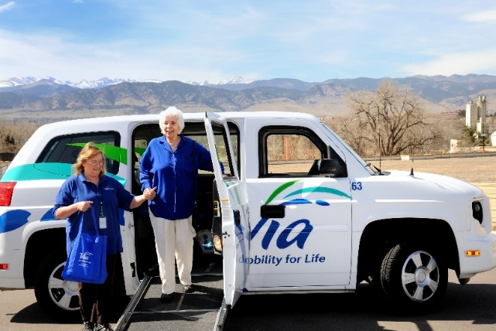
FTA 5310
5310 Certification (DTR)
Enhanced Mobility for Seniors and Persons with Disabilities
Identifies the type of organization you are
Enables CDOT to track eligibility and if there are any waivers/approvals required

Slide 15
FTA 5311
Annual Labor Certification
Report to Department of Labor on transit employee representation
Annual School Bus Certification (DTR)
Clarifies status under this regulation
Annual Charter Bus Certification (DTR)
Clarifies status and triggers quarterly reporting under this regulation
Drug & Alcohol reporting (DAMIS)

Slide 16
Plans on File
Allows CDOT to ensure compliance without asking grant partner for copies
Procurement Policy – Ensures compliance with Federal and State clauses
Asset Management Plan
Ensures grant partner plans ahead for replacements (Obligation minimized if under State plan)
Fleet Maintenance Plan/Policy
Ensures compliance with federal requirements including warranty, compliance with manufacturer’s guidelines

Slide 17
Plans on File - 2
Title VI Plan/LEP Plan
Law applies to everyone but plan only required of federal recipients
Includes public participation and limited English proficiency (LEP) plans
Must conduct an equity analysis for facilities
DBE Plan
For direct recipients with >$250,000 in contractingopportunities with federal funds (excluding TVM purchases)
All others fall under CDOT’s DBE Program and must report participation to CDOT semi-annually
EEO Plan
Law applies to everyone but plan is only required of federal recipients that receive >$1 million in capital and operating federal funding or $250k in planning funds for single year and have 50+ transit employees
ADA Programmatic Criteria
15+employees:
Must provide name of ADA coordinator
List of complaints
Location of postings against discrimination
Complaint resolution process

Slide 18
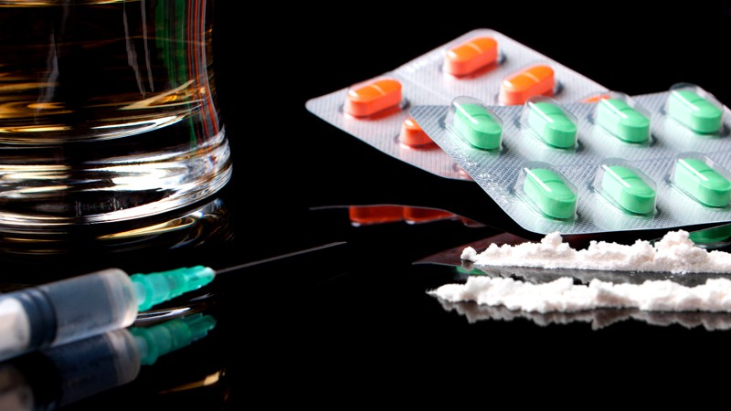
Plans on File - 3
ADA Service Plan
Required of fixed route operators
Drug & Alcohol Policy
For 5311 recipients
Outlines process for compliance with Drug & Alcohol regulations
Drug Free Workplace
Required of all federal funding recipients
Safety & Security Plan
Under development by FTA. Will be required upon final guidance

Slide 19
Program Compliance Reviews
Triennial Agency Reviews – Required by FTA to ensure that grant partners are meeting all compliance requirements
Covers all applicable areas of compliance
Desk review checks over plans and other documents on file
Site review provides in-depth review of compliance (answer questions) and includes review of documentation

Slide 20
Project Compliance Reviews
Specific by compliance area
Finance review: Covers all financial processes and procedures, ensures systems are compliant, includes finance records and retention policy, usually completed by financial expert
Procurement review: Covers procurement process and policies, ensures compliance with federal and state regulations, reviews 3-5 procurements from past 3 years including all records

Slide 21
Project Compliance Reviews cont…
Asset Management Review: Checks vehicle and facility records and plans, reviews asset management process including replacement determination and disposition process
Maintenance Review: Checks maintenance records to ensure compliance with manufacturer’s standards, and use of warranty

Slide 22
Project Compliance Reviews cont…
Civil Rights – Title VI, LEP, ADA, EEO, DBE
Since CDOT reviews/approves all plans, most reviews not needed
Usually only occur when complaints are noted
Most common is ADA

Slide 23
Project Compliance Reviews cont…
Safety & Security Review
When the guidance is issued, we will determine what may need to be in place for compliance

Slide 24
State Management Review
FTA performs this on CDOT every three years. Next one is 2018.
As part of the process, FTA selects at least two grant partners to do mini-reviews
Your obligation is to be available just like for DTR Agency review
Results are NOT negative for you, but are for DTR and could result in more oversight

Slide 25
Other FTA Reviews
Dependent on FTA
Could be on any topic area
Drug & Alcohol Program review: September 26-30, 2016
Same as SMR, grant partners are obligated to comply as if it were a state project compliance review
Results are reflection on DTR, not grant partner. Poor performance may result in more oversight

Slide 26
Risk Assessment
Required of all grant applications
2 CFR 200.331(b)
Requirements of pass-through entities
“Evaluate each subrecipient’s risk of noncompliance with Federal statutes, regulations, and the terms and conditions of the subaward for purposes of determining the appropriate subrecipient monitoring”
Simple 26 question tool – 3 levels of risk
Lo/No Risk
Medium Risk
High Risk

Slide 27
Risk = Oversight
Lo/No Risk
Minimum level of oversight
This is the target for all grant partners
Medium Risk
Requires more frequent oversight & support
May be project or category specific, i.e. maintenance or procurement
High Risk
Annual reviews, targeted technical assistance, more frequent site visits, monthly contact

Slide 28
Summary
Compliance is not simple
All money from CDOT has strings
DTR is held accountable for ensuring that you are compliant with the regulations and requirements
We want to make things as streamlined as possible
This has been a building year

Slide 29
Thanks for working with us!
We appreciate your patience and diligence

